Slide 1
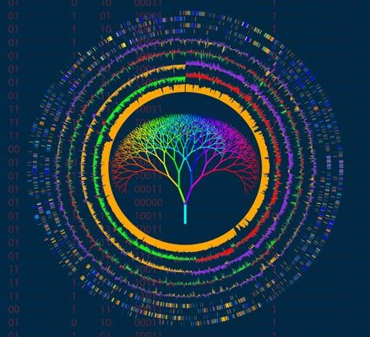
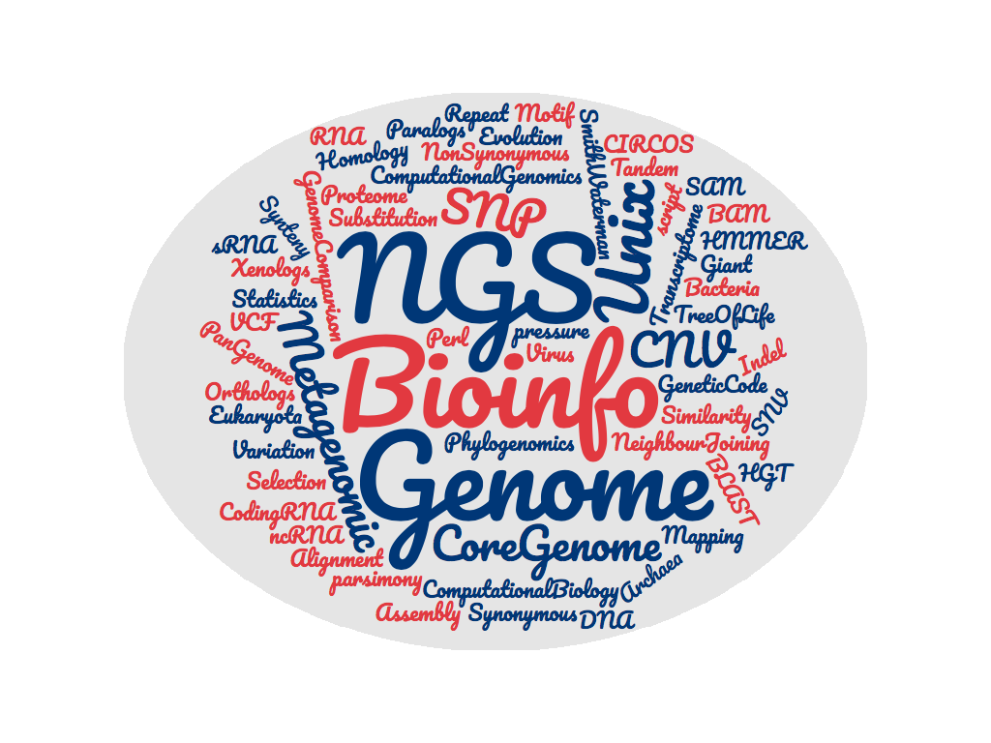
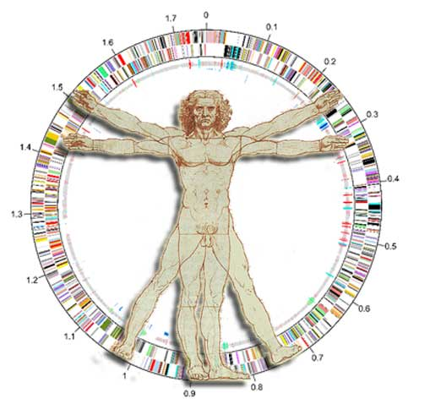
TATTTGATTTTTTGCTTAATTTTTATGTAATTACTTCCCCACAATTTTTGCCCACATATTGTGGATAAAT
ACCTTTAATCTAGAAATTACAATGAATGTTGTTGAAGAAGCACTTGGTGCTGTATTAAAAACTAAGAAGA
TTTCCACATTTTATTCACAATGTTGATAAGTTGTGTAAGTCGACTTGTTGGCTTTATAAAGCAAATGACA
CACTGAAAGTTATCCACAAACAAATTTTTCAAAAGTGTTTAAATCAAAAAGTTATCCACAAATAATGTGG
AAAACTTTTTAATAAATTTGTCGTTTCTTATGCTATCATAGTTTTACATAAATTATTAACTACTATAGGG
AGGCAGTCATGAGTCCAAACAGCACATTATGGCAGACAATATTACAGGATTTAGAAAAACTATACAACGA
GGAGACTTACAACGAGCTATTTCTACCAGTGACTTCTACTTTTAAAGATCAAAACGGATTACTTACAATG
GTTGTAGCTAATGAGTTCTTAAAGAATCGTATCAATAAACTATACATTGCAAAAATTAACGAACTTGCTA
CAAAATATTCAAGTACTCCAGTTAGATTGAAATTCGTATCACAAGAAGAAGTTATTGAAGAACCAGTAGC
TGATCGTAAATTAACCATTGATTATCGTCAAGGGAACTTAAACTCTACCTATACCTTTGACTCTTTTGTT
GTTGGAAAATCTAACATGTTTGCTTTTCGTATGGCGATGAAGGTTGCTGATCAACCTGGAGCAGTAGCAA
ACCCTTTCTACATATTTGGTGATGTAGGTTTAGGTAAAACCCATCTTATGCAAGCAATAGGTAACTATAT
ATTAGATAATGATGTCGAAAAACGTATCTTATATGTTAAAGCTGATAACTTTATTGAAGACTTTGTATCT
TTATTATCAAGAAACAAAAATAAGACTGAAGAATTCAATGCTAAATATAAAGATATTGACGTTATATTAG
TAGACGACATCCAAATTATGGCAAATGCTAGTAAAACTCAAATGGAATTCTTTAAGCTCTTTGACTACCT
ATATTTAAATAATAAACAAATCGTTATAACATCTGATAAACCAGCTTCACAATTAACAAATATCATGCCA
CGTTTAACGACACGTTTTGAAGCTGGTCTCTCTGTAGACATACAAATACCTGAATTAGAACATAGAATAA
GTATTTTAAAGAGAAAAACAGCTACATTAGATGCCAACTTAGAGGTAAGTGAGGATATTTTAACCTTTAT
AGCATCTCAATTTGCAGCAAACATTAGAGAAATGGAAGGTGCACTCATTCGTTTAATTAGTTATGCACAG
ACCTTTAATCTAGAAATTACAATGAATGTTGTTGAAGAAGCACTTGGTGCTGTATTAAAAACTAAGAAGA
AAACAAATGATTTAAACGAAAATAACTACGATAAGATCCAAAGTATTGTAGCAGATTACTTCCAAGTTTC
ATTACCAGACTTAATTGGTAAGAAAAGACATGCTAAATTCACATTACCTAGACATATAGCGATGTATCTT
ATTAAACTTAAATACAATATTCCTTATAAAACAATTGGATCTTTATTTAATGATAGAGACCACTCCACAG
TATTATCTGCTTGTGAAAAAGTAGAACGCGATATGAGGATGGATTCGAACTTAAAGTTTGCTGTTGACTC
GATTGTCAAAAAAATAGATTCACCATTATTAAAGTGATAAATGTTTATAAAAATGATTAAATGTGGTAAA
ATAAATGGTAGATGAAGCGATTATTGCTAGTTTCCCACTTTCCCACAGACACTAACAATAACAAAGAAGA
AATAATAATTAATAAAAGGGGTAAAATATGAATTTTACAATTGAAAGAGATATACGTTCAGTTAACCGGA
Introduction to Bioinformatics & Genomics
Fredj Tekaia
tekaia@pasteur.fr
Bioinformatics and Genome Analyses
Institut Pasteur Tunis, Tunisia. September 18 – December 15, 2017.

Slide 2
Plan
• Main genomes sequencing projects
• Bioinformatics in the Genome era
• Large-scale genome analyses/comparisons
(duplication, conservation, Orthologs inference, Genome trees, Phylogenomics, Horizontal Gene Transfer,…)
• Whole genome alignments
• Next Generation Sequencing & Applications - Metagenomics
• Genomic variation in human
• Synthetic Biology
• Concluding notes

Slide 3
What is a genome?
Genome
The genome of a cell is the complete genetic material which is contained in its chromosomes.
It is the full DNA sequence of the cell.
The genome size is the total of its DNA bases.

Slide 4
TATTTGATTTTTTGCTTAATTTTTATGTAATTACTTCCCCACAATTTTTGCCCACATATTGTGGATAAAT
ACCTTTAATCTAGAAATTACAATGAATGTTGTTGAAGAAGCACTTGGTGCTGTATTAAAAACTAAGAAGA
TTTCCACATTTTATTCACAATGTTGATAAGTTGTGTAAGTCGACTTGTTGGCTTTATAAAGCAAATGACA
CACTGAAAGTTATCCACAAACAAATTTTTCAAAAGTGTTTAAATCAAAAAGTTATCCACAAATAATGTGG
AAAACTTTTTAATAAATTTGTCGTTTCTTATGCTATCATAGTTTTACATAAATTATTAACTACTATAGGG
AGGCAGTCATGAGTCCAAACAGCACATTATGGCAGACAATATTACAGGATTTAGAAAAACTATACAACGA
GGAGACTTACAACGAGCTATTTCTACCAGTGACTTCTACTTTTAAAGATCAAAACGGATTACTTACAATG
GTTGTAGCTAATGAGTTCTTAAAGAATCGTATCAATAAACTATACATTGCAAAAATTAACGAACTTGCTA
CAAAATATTCAAGTACTCCAGTTAGATTGAAATTCGTATCACAAGAAGAAGTTATTGAAGAACCAGTAGC
TGATCGTAAATTAACCATTGATTATCGTCAAGGGAACTTAAACTCTACCTATACCTTTGACTCTTTTGTT
GTTGGAAAATCTAACATGTTTGCTTTTCGTATGGCGATGAAGGTTGCTGATCAACCTGGAGCAGTAGCAA
ACCCTTTCTACATATTTGGTGATGTAGGTTTAGGTAAAACCCATCTTATGCAAGCAATAGGTAACTATAT
ATTAGATAATGATGTCGAAAAACGTATCTTATATGTTAAAGCTGATAACTTTATTGAAGACTTTGTATCT
TTATTATCAAGAAACAAAAATAAGACTGAAGAATTCAATGCTAAATATAAAGATATTGACGTTATATTAG
TAGACGACATCCAAATTATGGCAAATGCTAGTAAAACTCAAATGGAATTCTTTAAGCTCTTTGACTACCT
ATATTTAAATAATAAACAAATCGTTATAACATCTGATAAACCAGCTTCACAATTAACAAATATCATGCCA
CGTTTAACGACACGTTTTGAAGCTGGTCTCTCTGTAGACATACAAATACCTGAATTAGAACATAGAATAA
GTATTTTAAAGAGAAAAACAGCTACATTAGATGCCAACTTAGAGGTAAGTGAGGATATTTTAACCTTTAT
AGCATCTCAATTTGCAGCAAACATTAGAGAAATGGAAGGTGCACTCATTCGTTTAATTAGTTATGCACAG
ACCTTTAATCTAGAAATTACAATGAATGTTGTTGAAGAAGCACTTGGTGCTGTATTAAAAACTAAGAAGA
AAACAAATGATTTAAACGAAAATAACTACGATAAGATCCAAAGTATTGTAGCAGATTACTTCCAAGTTTC
ATTACCAGACTTAATTGGTAAGAAAAGACATGCTAAATTCACATTACCTAGACATATAGCGATGTATCTT
ATTAAACTTAAATACAATATTCCTTATAAAACAATTGGATCTTTATTTAATGATAGAGACCACTCCACAG
TATTATCTGCTTGTGAAAAAGTAGAACGCGATATGAGGATGGATTCGAACTTAAAGTTTGCTGTTGACTC
GATTGTCAAAAAAATAGATTCACCATTATTAAAGTGATAAATGTTTATAAAAATGATTAAATGTGGTAAA
ATAAATGGTAGATGAAGCGATTATTGCTAGTTTCCCACTTTCCCACAGACACTAACAATAACAAAGAAGA
AATAATAATTAATAAAAGGGGTAAAATATGAATTTTACAATTGAAAGAGATATACGTTCAGTTAACCGGA

Slide 5
First Sequences
• The first protein sequencing was achieved
by Frederic Sanger in 1953.
He determined the amino acid sequence of the B chain bovine insulin
• Wu and Kaiser published the first successful DNA sequence of the bacteriophage lambda in 1968.
The early days of DNA sequences.Sanger F.Nat Med. 2001 Mar;7(3):267-8.

Slide 6
1976
Complete sequence of the viral RNA genome of a bacteriophage MS2 (Walter Fiers et al. 3569 bp).
Viral genome (5368 base pairs; encoding 11 genes). Sanger et al. sequence bacteriophage φX174.
1977
Human mitochondrial genome 16,500 base pairs (encodes 13 proteins, 2 rRNA, 22 tRNA)(Sanger et al.)
1981
1984
Complete sequence of the HIV-1 genome was determined (9749bp).
1986
Chloroplast genome 156,000 base pairs

Slide 7
First genome of a free-living organism, the bacterium Haemophilus influenzae, by TIGR, 1830 Kb, 1713 genes.
1995
Starting year of Genomics
First eukaryotic genome : Saccharomyces cerevisiae S288C; International collaboration; 16 Chromosomes; 12,057 Mb, ~6000 genes.
1996
First multicellular organism. Nematode Caenorhabditis elegans; 97 Mb; ~19,000 genes.
1998

Slide 8
Fruitfly Drosophila melanogaster (137 Mb; ~13,000 genes)
2000
First plant genome: Arabidopsis thaliana (115,428 Mb; 22670 genes)
First draft of the human genome (~3000 Mb; 200000 gaps, 28000 genes!).
2001
2004
First Reference of the human genome (300 gaps)

Slide 9
Recently:
• Gordon D, et al. (2016). Long-read sequence assembly of the gorilla genome. Sciences. 352 (6281). 53-57.
High-quality assembly of the gorilla genome using single-molecule real-time (SMRT) sequence technology and a string graph de novo assembly algorithm.
• Seo Jeong-Sun et al. (2016). Nature doi: 10.1038/nature20098. De novo assembly and phasing of a Korean human genome.

Slide 10
Tardigrades: supreme resistant!
2017
Yoshida et al. 2017. Comparative genomics of the tardigrades Hypsibius dujardiniand Ramazzottius varieornatus. PLoS Biol. 2017 Jul 27;15(7): e2002266.
https://doi.org/10.1371/journal.pbio.2002266

Slide 11
In between:
many large genome projects

Slide 12
Human 1000 genomes project (2500 individuals)
A global reference for human genetic variation
Nature 526, 68-74 (01 October 2015) doi:10.1038/nature15393
Human Microbiome Project (HMP)
http://commonfund.nih.gov/hmp/
Develop research resources to enable the study of the microbial communities that live in and on our bodies and the roles they play in human health and disease.
International Cancer Genome Consortium (https://icgc.org/)
Cancer Genome Project (74 project teams) 50 tumor types

Slide 13
Genomic England: The 100K Genomes Project https://www.genomicsengland.co.uk/the-100000-genomes-project/
The project will sequence 100,000 genomes from around 70,000 people. Participants are National Health Service patients with rare diseases, plus their families, and patients with cancer.
100K Pathogen Genome Project: http://100kgenome.vetmed.ucdavis.edu/index.cfm
The 100K Pathogen Genome Project aims to address the persistent food safety concerns and create a publicly available genetic database of the most common foodborne disease causing microbes.

Slide 14
1001 genomes project
Arabidopsis thaliana Genetic Variation
The 3000 rice genomes project
GigaScience Database: http://gigadb.org/dataset/200001
http://1000.fungalgenomes.org/home/
http://1000bullgenomes.com
Earth Microbiome project; Cancer genome project; ….

Slide 15
Genomic island
Nature Genetics 47, 1221 (2015) doi:10.1038/ng.3436
• Genome of the Netherlands (GoNL)(Nat. Genet. 46, 818-825, 2014)
Whole Genome of 250 Dutch parent-offspring families
• Iceland (http://www.nature.com/ng/focus/icelanders/)
whole genomes of 2,636 Icelanders
• The UK (Nature 526, 82-90, 2015; doi:10.1038/nature14962)
http://www.uk10k.org/
The UK10K project identifies rare variants in health and disease
•The SardiNIA Project (https://sardinia.irp.nia.nih.gov/)
Identify genetic bases for prominent age-associated changes

Slide 16
Evolutionary history of Tibetans inferred from whole-genome sequencing
Genes EPAS1 and EGLN1, associated with high-altitude adaptations were expressing in Tibetan natives.
The gene EPAS1 shares variants with the ancient Denisovan genome, which diverged from Tibetan populations about a million years ago.
EPAS1 appears to have been retained due to its adaptive advantage in altitudes.
Hu H, Petousi N, Glusman G, Yu Y, Bohlender R, Tashi T, et al. (2017) Evolutionary history of Tibetans inferred from whole-genome sequencing. PLoS Genet 13(4): e1006675. https:// doi.org/10.1371/journal.pgen.1006675

Slide 17
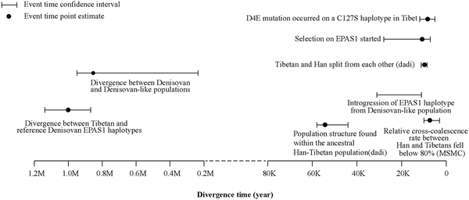

Fig 5. Timeline of important evolutionary events in the demographic history of Tibetans.
Hu H, Petousi N, Glusman G, Yu Y, Bohlender R, et al. (2017) Evolutionary history of Tibetans inferred from whole-genome sequencing. PLOS Genetics 13(4): e1006675. https://doi.org/10.1371/journal.pgen.1006675
http://journals.plos.org/plosgenetics/article?id=10.1371/journal.pgen.1006675

Slide 18
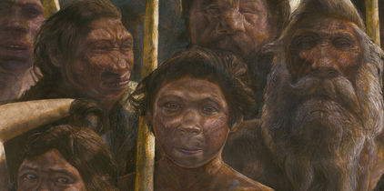
Ancient DNA sequencing
Harnessing ancient genomes to study the history of human adaptation
Stephanie Marciniak & George H. Perry. doi:10.1038/nrg.2017.65. https://www.nature.com/nrg/journal/vaop/ncurrent/pdf/nrg.2017.65.pdf

Slide 19
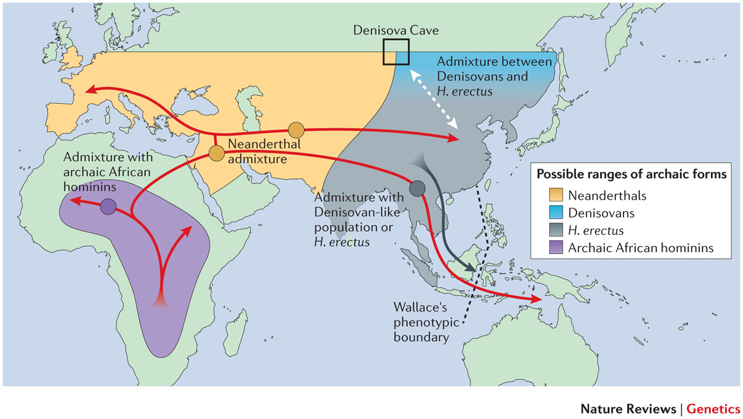
The impact of whole-genome sequencing on the reconstruction of human population history
Krishna R. Veeramah & Michael F. Hammer (2014). The impact of whole-genome sequencing on the reconstruction of human population history. Nature Reviews Genetics 15, 149-162 (2014)

Slide 20
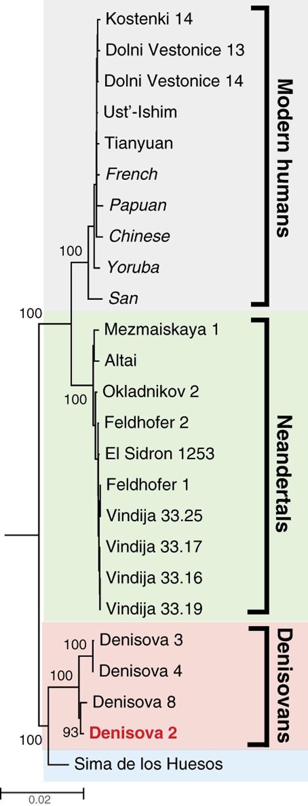
Fig. 1. Maximum likelihood tree relating the Denisova 2 mtDNA to other ancient and present-day mtDNAs.
A fourth Denisovan individual
Slon et al., Sci. Adv. 2017;3: e1700186
Notes:
Fig. 1. Maximum likelihood tree relating the Denisova 2 mtDNA to other ancient
and present-day mtDNAs. The Denisova 2 mtDNA (in red) clusters with the
three previously determined Denisovan mtDNAs, to the exclusion of Neandertals
and modern humans. Present-day human mtDNA sequences are noted in italics.
The tree was rooted using a chimpanzee mtDNA sequence (not shown). Support
for each branch is based on 500 bootstrap replications. The tree is drawn to scale,
with branch lengths measured in the number of substitutions per site. Accession
codes for the comparative data and the geographical origins of ancient individuals
are presented in table S5.

Slide 21
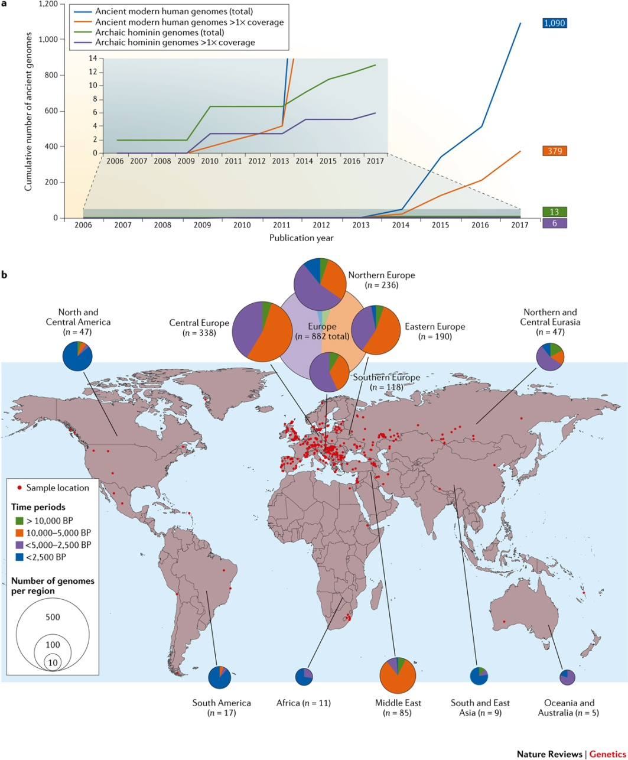
The recent (and ongoing) ancient genomic explosion
The past several years have witnessed an explosion of successful ancient human genome-sequencing projects, with genomic-scale ancient DNA data sets now available for more than 1,100 ancient human and archaic hominin (for example, Neandertal) individuals.
Recent 'evolution in action' analyses have started using these data sets to identify and track the spatiotemporal trajectories of genetic variants associated with human adaptations to novel and changing environments, agricultural lifestyles, and introduced or co-evolving pathogens.
Harnessing ancient genomes to study the history of human adaptation (2017).
Stephanie Marciniak & George H. Perry Nature Reviews Genetics (2017) doi:10.1038/nrg.2017.65.
Notes:
a | Cumulative counts of the numbers of ancient human and archaic hominin individuals with available ancient genomic data (whole genome sequences, exomes, and genome-scale single-nucleotide polymorphism data sets), by year of publication. For each category, both the total number of individuals and the subset of that sample with an average of >1 sequence read per targeted site are depicted. b | A spatiotemporal distribution of ancient human and archaic hominin genome data sets, where the areas of the circles are proportional to the genome counts. For some archaeological sites, precise geographic coordinates were not indicated in the corresponding publication; longitude and latitude were estimated in these cases. A summary of the published studies and data sets represented in the figure is provided in Table 1.

Slide 22
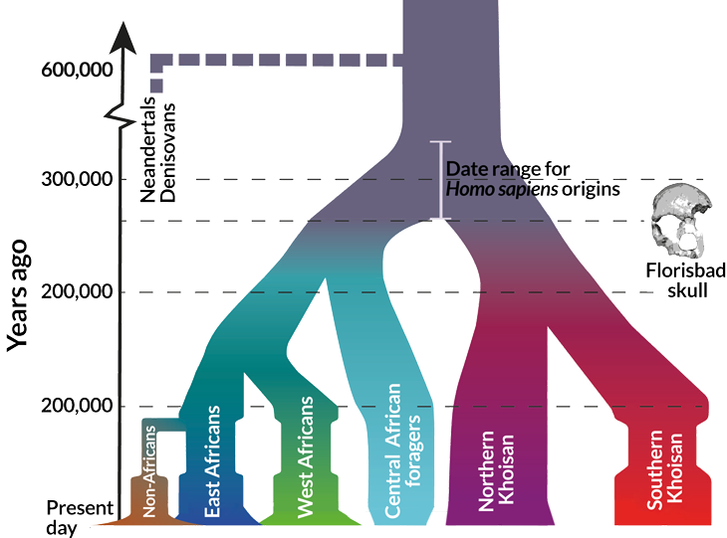
Homo sapiens may have emerged as a genetically distinct species as early as 350,000 years ago.
Ancient boy’s DNA pushes back date of earliest humans
African populations branch in two directions and then further subdivide around 200,000 years ago. Non-African populations, bottom left, appeared shortly after 100,000 years ago.
Science. 2017; 358(6363):652-655
Notes:
Ancient splits
In this diagram based on a new DNA study, Homo sapiens originates as a genetically distinct species between 350,000 and 260,000 years ago. African populations branch in two directions and then further subdivide around 200,000 years ago. Non-African populations, bottom left, appeared shortly after 100,000 years ago.

Slide 23
Neandertal Genome Analysis Consortium Tracks at UCSC
http://genome.ucsc.edu/Neandertal/

Slide 24
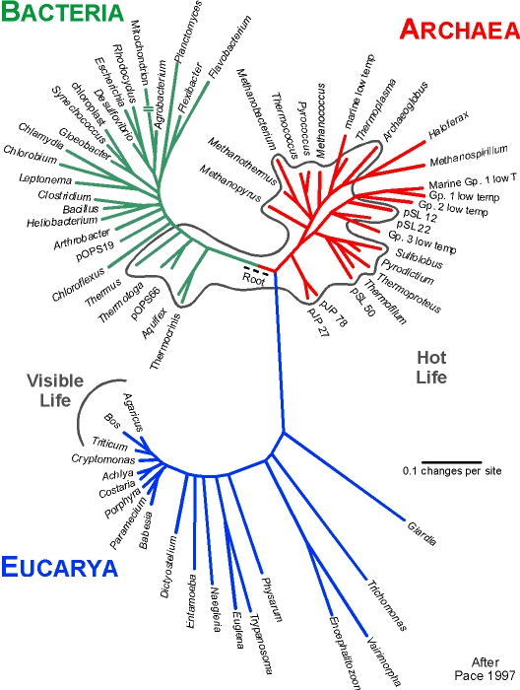
10/05/2017
TATTTGATTTTTTGCTTAATTTTTATGTAATTACTTCCCCACAATTTTTGCCCACATATTGTGGATAAAT
ACCTTTAATCTAGAAATTACAATGAATGTTGTTGAAGAAGCACTTGGTGCTGTATTAAAAACTAAGAAGA
TTTCCACATTTTATTCACAATGTTGATAAGTTGTGTAAGTCGACTTGTTGGCTTTATAAAGCAAATGACA
CACTGAAAGTTATCCACAAACAAATTTTTCAAAAGTGTTTAAATCAAAAAGTTATCCACAAATAATGTGG
AAAACTTTTTAATAAATTTGTCGTTTCTTATGCTATCATAGTTTTACATAAATTATTAACTACTATAGGG
AGGCAGTCATGAGTCCAAACAGCACATTATGGCAGACAATATTACAGGATTTAGAAAAACTATACAACGA
GGAGACTTACAACGAGCTATTTCTACCAGTGACTTCTACTTTTAAAGATCAAAACGGATTACTTACAATG
GTTGTAGCTAATGAGTTCTTAAAGAATCGTATCAATAAACTATACATTGCAAAAATTAACGAACTTGCTA
CAAAATATTCAAGTACTCCAGTTAGATTGAAATTCGTATCACAAGAAGAAGTTATTGAAGAACCAGTAGC
TGATCGTAAATTAACCATTGATTATCGTCAAGGGAACTTAAACTCTACCTATACCTTTGACTCTTTTGTT
GTTGGAAAATCTAACATGTTTGCTTTTCGTATGGCGATGAAGGTTGCTGATCAACCTGGAGCAGTAGCAA
ACCCTTTCTACATATTTGGTGATGTAGGTTTAGGTAAAACCCATCTTATGCAAGCAATAGGTAACTATAT
ATTAGATAATGATGTCGAAAAACGTATCTTATATGTTAAAGCTGATAACTTTATTGAAGACTTTGTATCT
TTATTATCAAGAAACAAAAATAAGACTGAAGAATTCAATGCTAAATATAAAGATATTGACGTTATATTAG
TAGACGACATCCAAATTATGGCAAATGCTAGTAAAACTCAAATGGAATTCTTTAAGCTCTTTGACTACCT
ATATTTAAATAATAAACAAATCGTTATAACATCTGATAAACCAGCTTCACAATTAACAAATATCATGCCA
CGTTTAACGACACGTTTTGAAGCTGGTCTCTCTGTAGACATACAAATACCTGAATTAGAACATAGAATAA
GTATTTTAAAGAGAAAAACAGCTACATTAGATGCCAACTTAGAGGTAAGTGAGGATATTTTAACCTTTAT
AGCATCTCAATTTGCAGCAAACATTAGAGAAATGGAAGGTGCACTCATTCGTTTAATTAGTTATGCACAG
ACCTTTAATCTAGAAATTACAATGAATGTTGTTGAAGAAGCACTTGGTGCTGTATTAAAAACTAAGAAGA
AAACAAATGATTTAAACGAAAATAACTACGATAAGATCCAAAGTATTGTAGCAGATTACTTCCAAGTTTC
ATTACCAGACTTAATTGGTAAGAAAAGACATGCTAAATTCACATTACCTAGACATATAGCGATGTATCTT
ATTAAACTTAAATACAATATTCCTTATAAAACAATTGGATCTTTATTTAATGATAGAGACCACTCCACAG
TATTATCTGCTTGTGAAAAAGTAGAACGCGATATGAGGATGGATTCGAACTTAAAGTTTGCTGTTGACTC
GATTGTCAAAAAAATAGATTCACCATTATTAAAGTGATAAATGTTTATAAAAATGATTAAATGTGGTAAA
ATAAATGGTAGATGAAGCGATTATTGCTAGTTTCCCACTTTCCCACAGACACTAACAATAACAAAGAAGA
AATAATAATTAATAAAAGGGGTAAAATATGAATTTTACAATTGAAAGAGATATACGTTCAGTTAACCGGA
Complete sequenced genomes: 7176
• 6624 Bacteria
• 254 Archaea
• 298 Eukaryotes
6624
254
Incomplete genomes: 15044
• 10237 Bacteria
• 314 Archaea
• 4493 Eukaryotes
Tree of life
Permanent Draft genomes: 67047
• 63632 Bacteria
• 698 Archaea
• 2717 Eukaryotes
298
Transciptomes: 72/5557
• 51/243 Bacteria
• 0/88 Archaea
• 21/5226 Eukaryota
http://www.genomesonline.org/
Viruses: • Completed: 3502 • Permanent draft: 3057

Slide 25
Bacteria: Phylum distribution of 6624 completely sequenced genomes

Slide 26
Eukaryotes: Phylum distribution of 298 completely sequenced genomes
Notes:
Streptophyta: plants
Chrodata: animal class(including fish, amphibians,..)

Slide 27
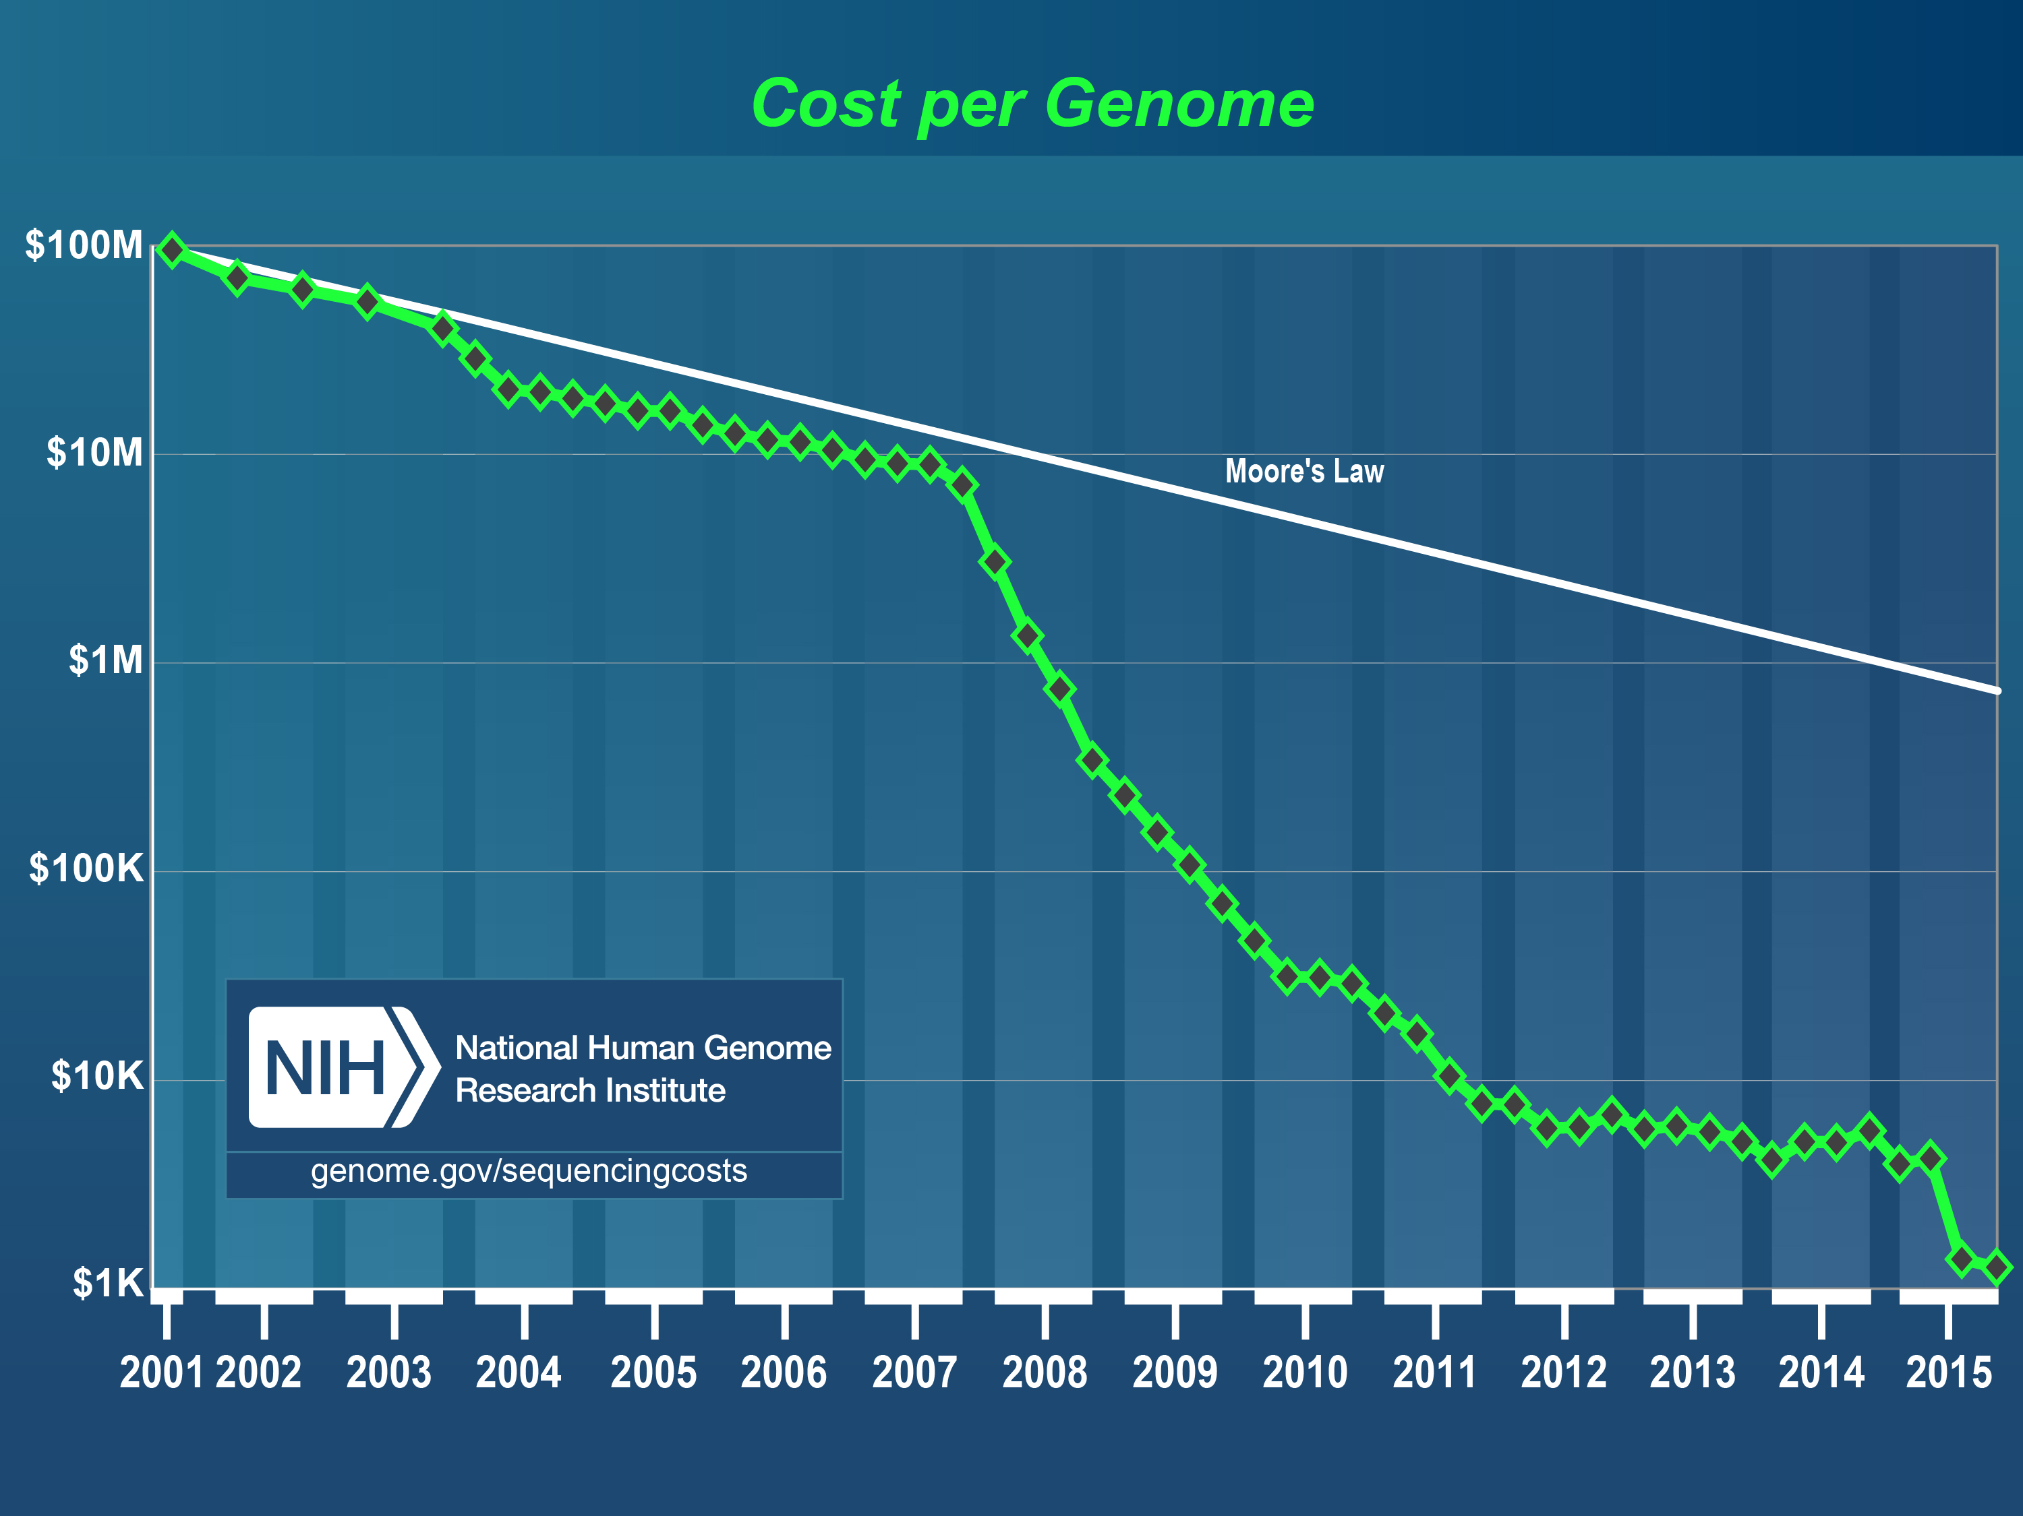
http://www.genome.gov/sequencingcosts/
"Moore's Law", states that the number of transistors on a chip will double about every two years.
Human genome:
First draft in 2001, final 2004. Estimated costs $3 billions. Time 13 years/Now few days.
NGS caused costs to drop faster than would be expected by Moore’s law.
A personal genome dropped to $1245 in 2017 from $340,000 in 2008.
New NGS
A full Bacterial/Archaean genome costs < US$100.
https://www.scienceexchange.com/services/whole-genome-seq

Slide 28
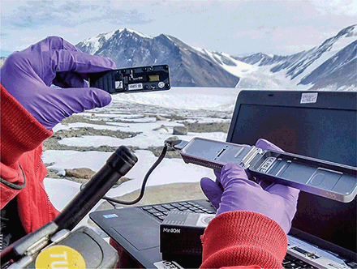
Pocket-sized sequencers start to pay off big
In Antarctica, the MinION proved capable of sequencing well even under harsh conditions
Elizabeth Pennisi 2017). Science 356 (6338), 572-573.

Slide 29
• Actually generation of data is faster and easier than analysing data
➔ Importance of Bioinformatics
• Bioinformatics is increasingly becoming important in translating the data into scientific knowledge leading to new biological insights.

Slide 30
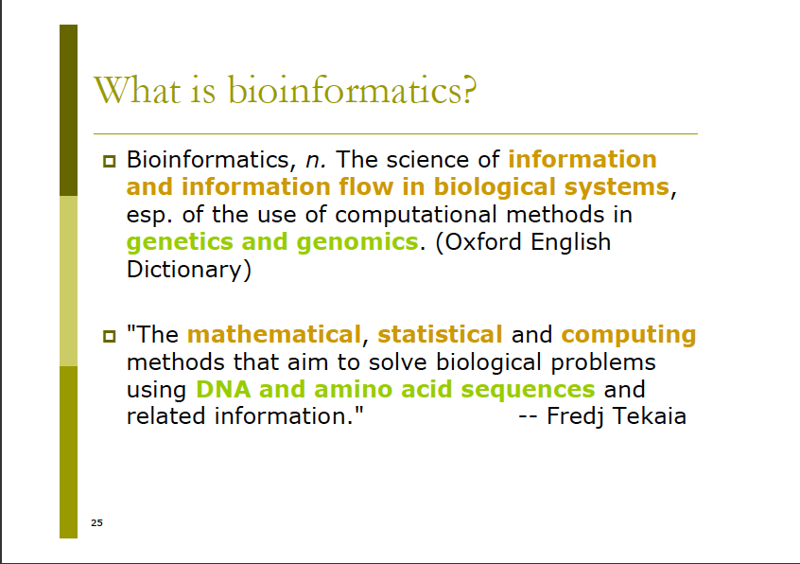
In the …90th
http://bioinformaticsweb.net/definition.html
http://www.bioinformatics.org/wiki/bioinformatics

Slide 31
Mathematics
Statistics
Bioinformatics
Nucleotide & protein sequences and related information
Biology
Computer Science
Notes:
Add complementary material to comply with actual use of Bioinformatics
The primary goal of bioinformatics is to increase the understanding of biological processes, focusing on developing and applying computationally intensive techniques such as pattern recognition, data mining, machine learning algorithms and visualization. These techniques are then harnessed towards answering biological questions which cannot be tackled by traditional approaches.

Slide 32
• Bioinformatics is expected to help in understanding biological processes, by developing and applying computational methods and techniques so that to answer biological questions.

Slide 33
Co-evolution of sequencing and computing

Slide 34
Bioinformatics has now firmly established itself as a scientific discipline.

Slide 35
Distribution of the number of Publications including the word “Bioinformatic” in Pubmed

Slide 36
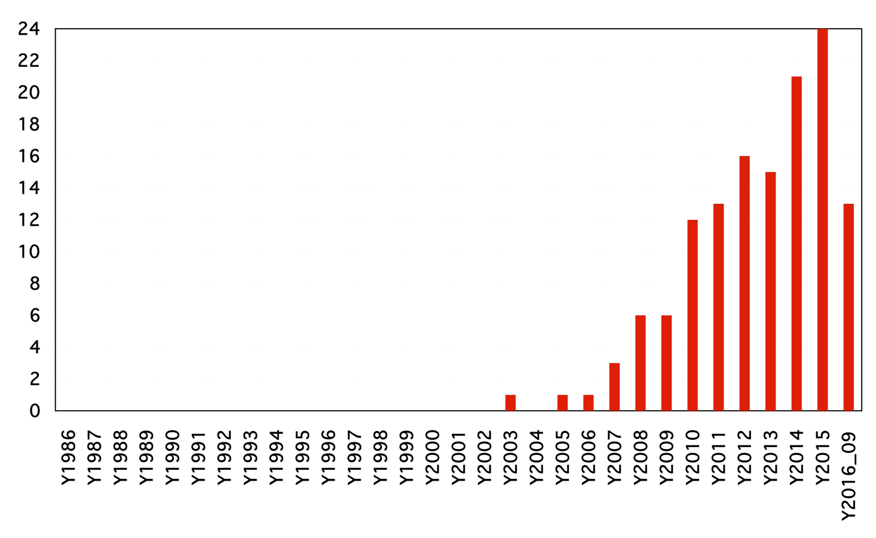
Distribution of the number of Publications including the words “Bioinformatic” and “Tunisia” in PubMed

Slide 37
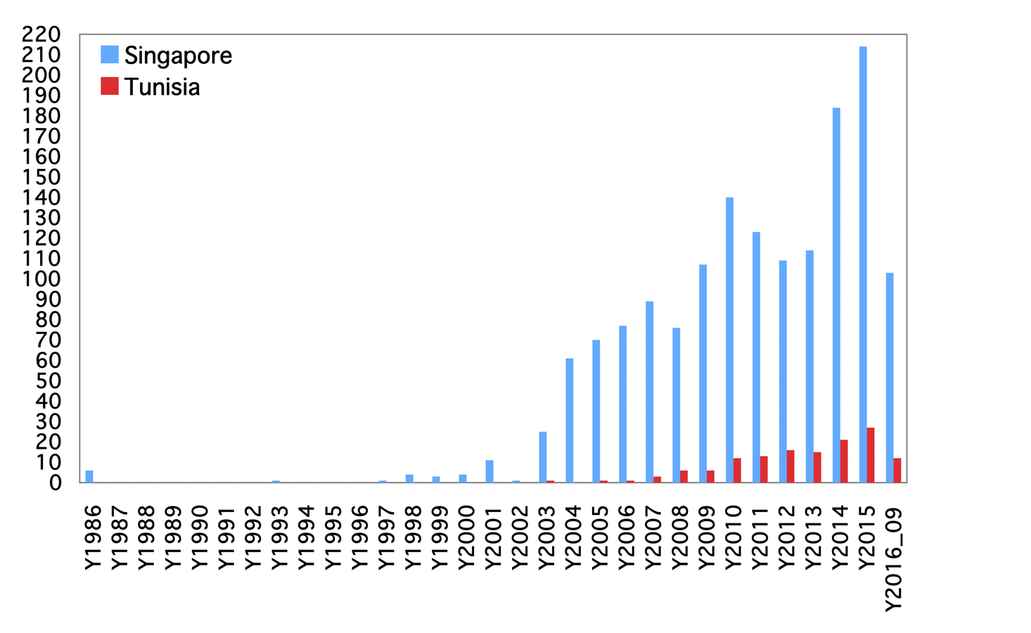
Distribution of the number of publications in PubMed including the words: “Bioinformatic” and “Tunisia” respectively “Bioinformatics” and “Singapore”

Slide 38
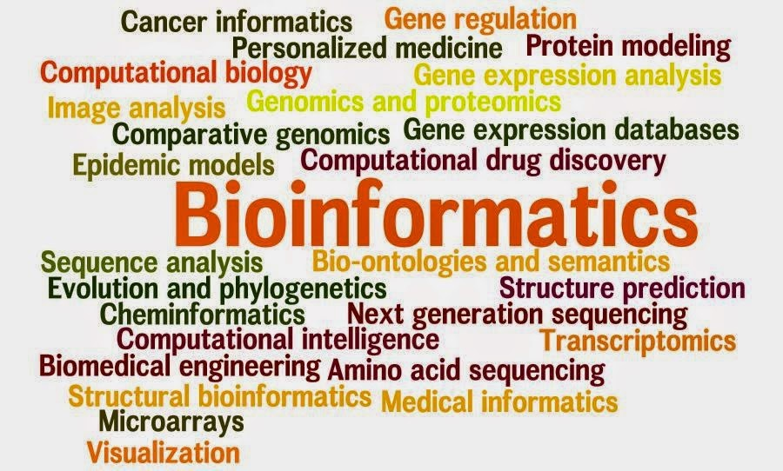

Slide 39
Genome studies show that:
• Access to entire genome sequences has revolutionized our understanding of how genetic information is stored and organized in DNA, and how it has evolved over time.
• The sequence of a genome provides significant details of the gene catalogue within a species.
• Comparisons of complete genome sequences show the acceleration in the understanding of species organisation, links between genes, functions of the genes, evolution of genes, genomes and species.
=> Beyond fundamental biological and methodological interests, Applications include: Drug, Medical and Agricultural,… discoveries… and thus health and economical consequences.

Slide 40
Boinformatics: Three main directions
• Genome evolution
• Genomic/Genetic variation
• Structural Genetics/Genomics

Slide 41
Genomic/Genetic variation
Evolution: inter-species variation
comparative studies of genetic variation between species, including unexplored species
Genetic variation: intra-species variation
Develop a general methodological framework to analyse the contribution of genetic variation to any phenotype
Disease models and mechanisms
Use human sequence data and model systems to understand disease

Slide 42
Bioinformatics Before the genome era - at the sequence level
Main topics include:
• Search for similarity
• Multiple alignments
• Motifs finding
• Phylogeny - Evolution
Topics of these 2 weeks

Slide 43
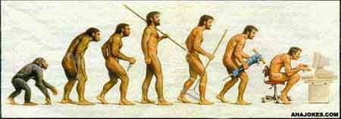
"Nothing in Biology makes sense except in the light of evolution”
Christian Theodosius Dobzhansky, 1973.

Slide 44
Search for similarity
One of the most frequent activity in Bioinformatics
Common ancestor
Two genes are homologs if and only if they derive from the same ancestor
Gene1
Gene2
Homology is inferred by sequence similarity
Notes:
Characterization of any new DNA or protein sequence starts with a database search aiming at finding out whether homologs of this gene (protein) are already available, and if they are, what is known about them.

Slide 45
Sequence similarity search
http://blast.ncbi.nlm.nih.gov/Blast.cgi

Slide 46
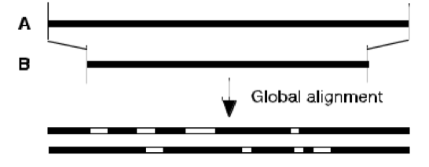
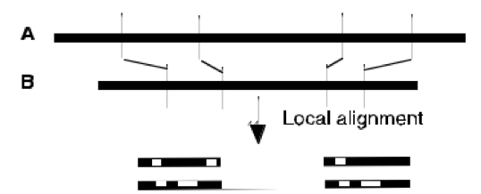
Alignments
Local Alignment
Global Alignment
• Clustal (w, x..)
• Multalign
• T-coffee
• MUSCLE
• MSA
•Probcons
• MAFFT
• DIALIGN
• Kalign
http://www.expasy.org/genomics/sequence_alignment

Slide 47
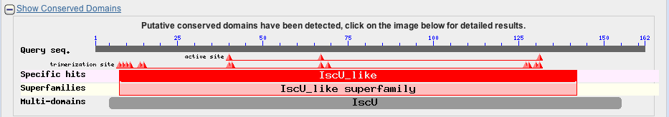
Motifs finding and Signals
• Is there any known motif (domain) in my sequence?
rpsblast versus Common Domains Database (CDD/ncbi)
http://www.ncbi.nlm.nih.gov/Structure/cdd/wrpsb.cgi

Slide 48
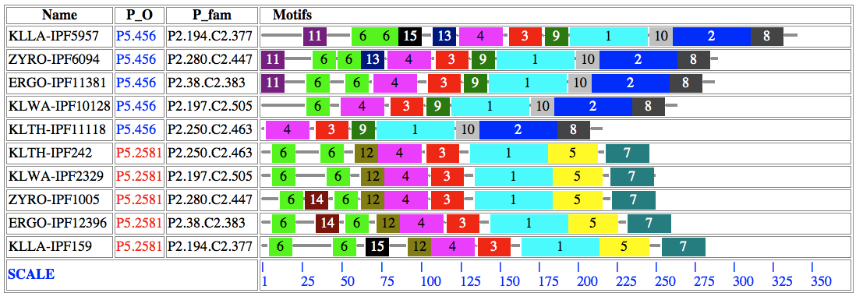
Motifs finding and Signals
• MEME/MAST find commun motifs in a set of sequences
http://meme-suite.org/
SPO10.135

Slide 49
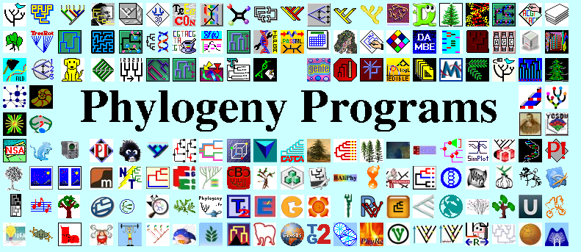
Phylogeny - Evolution
http://evolution.genetics.washington.edu/phylip/software.html
Includes a large list of methods and programs

Slide 50
Bioinformatics in the genome era
--> Methods used at large-scale
•Genome assembly/Gene prediction resources
•Large-scale genome comparisons
-Paralogs, Orthologs inference and clustering
-Phylogenomics
•Whole genome alignments
•Relationships visualization
New tools and methods for NGS data analyses

Slide 51
Gene prediction resources
From newly sequenced genomes, most popular:
Eukaryotes:
• Genscan
http://genes.mit.edu/GENSCANinfo.html
• Genmark
http://opal.biology.gatech.edu/GeneMark/
Prokaryotes:
• Glimmer
http://ccb.jhu.edu/software/glimmer/index.shtml

Slide 52
Large-scale genome comparisons
•Duplication (genes, chromosome segments, whole genome)
•Conservation (genes, chromosomes, segments);
•Specificity (species-specific genes);
•Inferring Paralogs, orthologs and clustering;
• Shared motifs in clusters of paralogs, orthologs;
• Protein conservation profiles;
•Gene Transfer, introgression between species;

Slide 53
Comparing genomes
Intra-species
A
A
Inter-species
A
C
B

Slide 54
Large-scale comparative analyses of proteomes revealed significant evolutionary processes:
Expansion, Exchange and Reduction.
Evolutionary processes include
Expansion*
Ancestor
duplication
Phylogeny*
segmental dup.
Whole Genome Dup.
genesis
HGT
species genome
HGT
introgression
Exchange*
Reduction*
Rearrangements*
loss

Slide 55
Comparing genomes
Intra-species Comparisons
A
A
• Rate of ancestral duplication
i.e non-unique genes / total number of genes in A.
• Families of genes - Orphans - Organisation

Slide 56
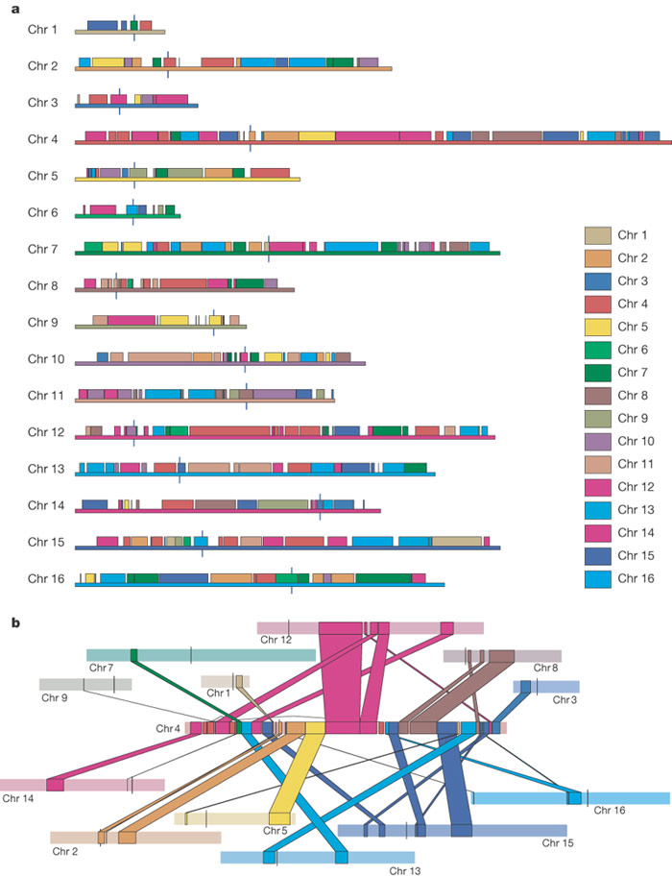
S. cerevisiae genome
Colours reveal Duplicated Blocks
Kellis et al. 2004. Nature, 428:617-24.

Slide 57
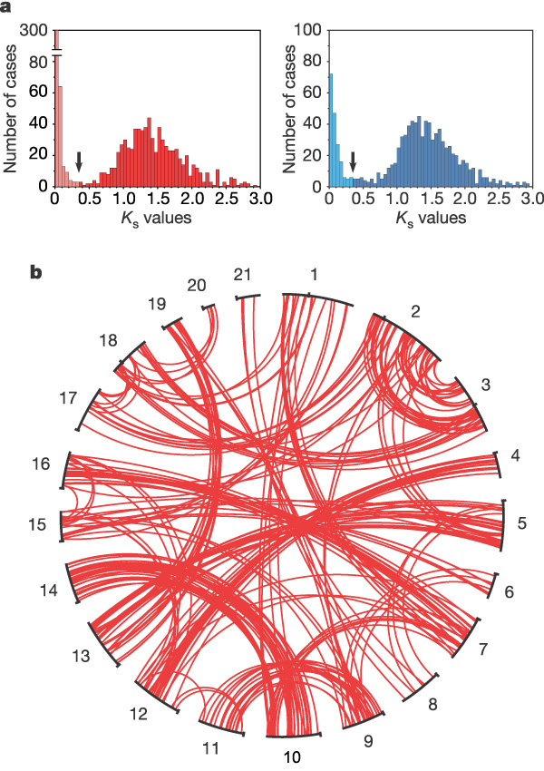
Genome duplication.
a, Distribution of Ks values of duplicated genes in Tetraodon (left) and Takifugu (right) genomes. Duplicated genes broadly belong to two categories, depending on their Ks value being below or higher than 0.35 substitutions per site since the divergence between the two puffer fish (arrows).
b, Global distribution of ancient duplicated genes (Ks > 0.35) in the Tetraodon genome. The 21 Tetraodon chromosomes are represented in a circle in numerical order and each line joins duplicated genes at their respective position on a given pair of chromosomes.
Tetraodon genomes
Jaillon et al. Nature 431, 946-857. 2004.

Slide 58
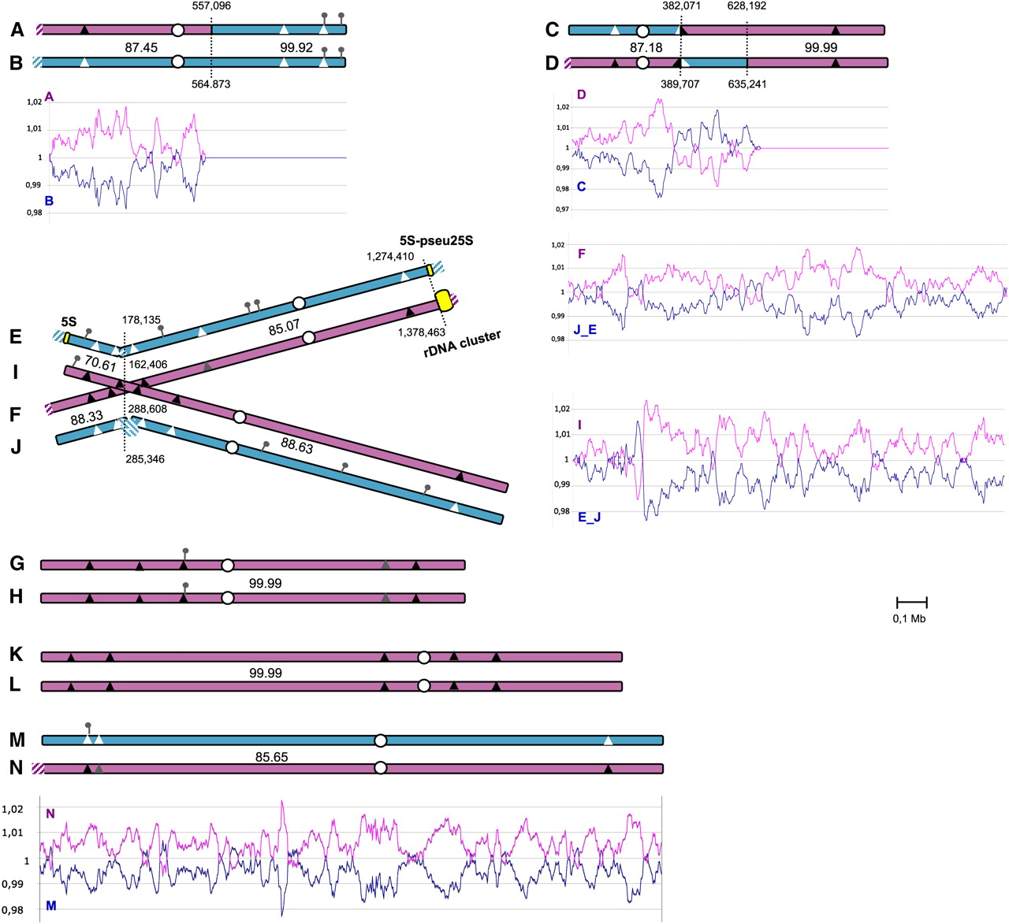
The hybrid nuclear genome of P. sorbitophila
Whole genome duplication Pichia sorbitophila
Louis et al. G3. 2;299-311. (2012).
©2012 by Genetics Society of America
Notes:
The hybrid nuclear genome of P. sorbitophila. The 14 chromosomes are represented by pairs according to their synteny. Chromosomes A/B and C/D are partly heterozygous, partly homozygous. Chromosomes E/F/I/J and M/N are heterozygous, and G/H and K/L are homozygous. The translocation breakpoint observed between chromosomes E, F, I, and J is represented by crossed chromosomes. Red and blue colors correspond to the proposed Pγ and Pε parental subgenomes, respectively, and hatched boxes to synteny losses between the homeologous chromosomes. Percentages of nucleotide identity between heterozygous regions are also indicated. Position of predicted centromeres (Figure S4) and of the 15 clusters of NUMT loci comprising a total of 24 NUMTs (Table S3) are shown by white dots and pins, respectively. Triangles indicate the positions of selected sequences used in P. farinosa CBS2001 strain (Table S4). The nucleotide identity level observed between P. sorbitophila and P. farinosa for the selected sequences is represented as followed: black triangles for 100% identity, gray for 99% and white for less than 96%. Below each chromosome pair (or at right for the crossed chromosomes) is represented the GC content variation (as shown in Materials and Methods and Figure S5) calculated for genes present at two allelic copies in chromosome pairs. The colors for curves correspond to subgenomes as for chromosomes.

Slide 59
Comparing genomes
Inter-species comparisons
A
C
B
• Rate of ancestral conservation of one species in another species;
i.e genes in A that are conserved in B / total number of genes in A; etc…
• specific, core-genome, pan-genome, orthologs, synteny, HGT, loss, introgression

Slide 60
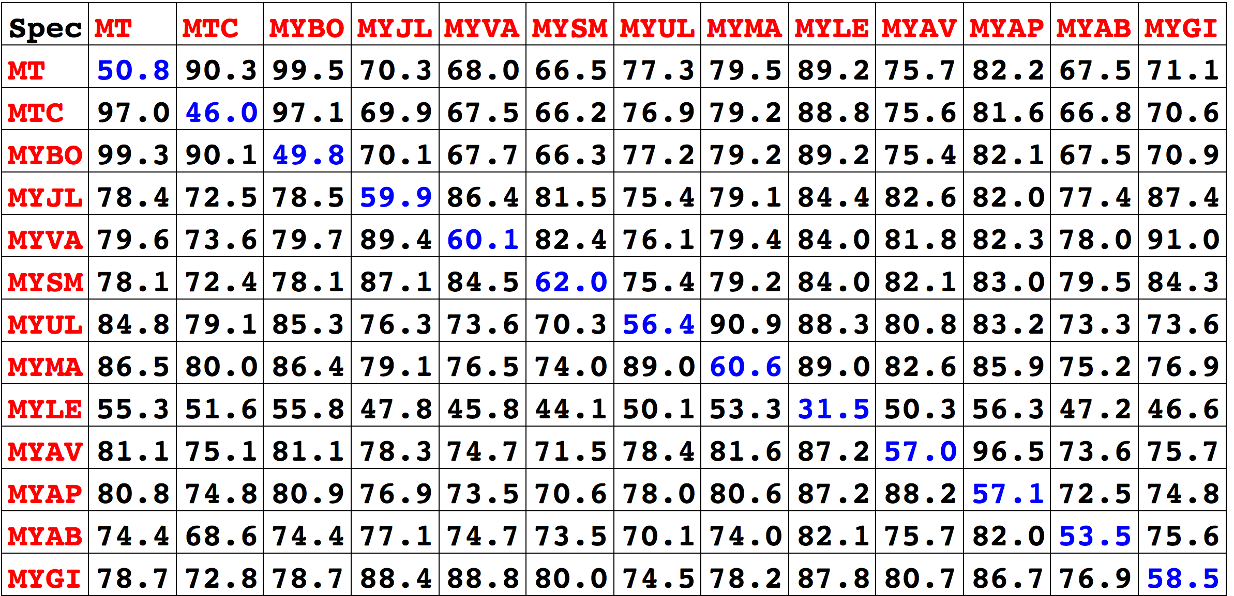
conservation
duplication

Slide 61
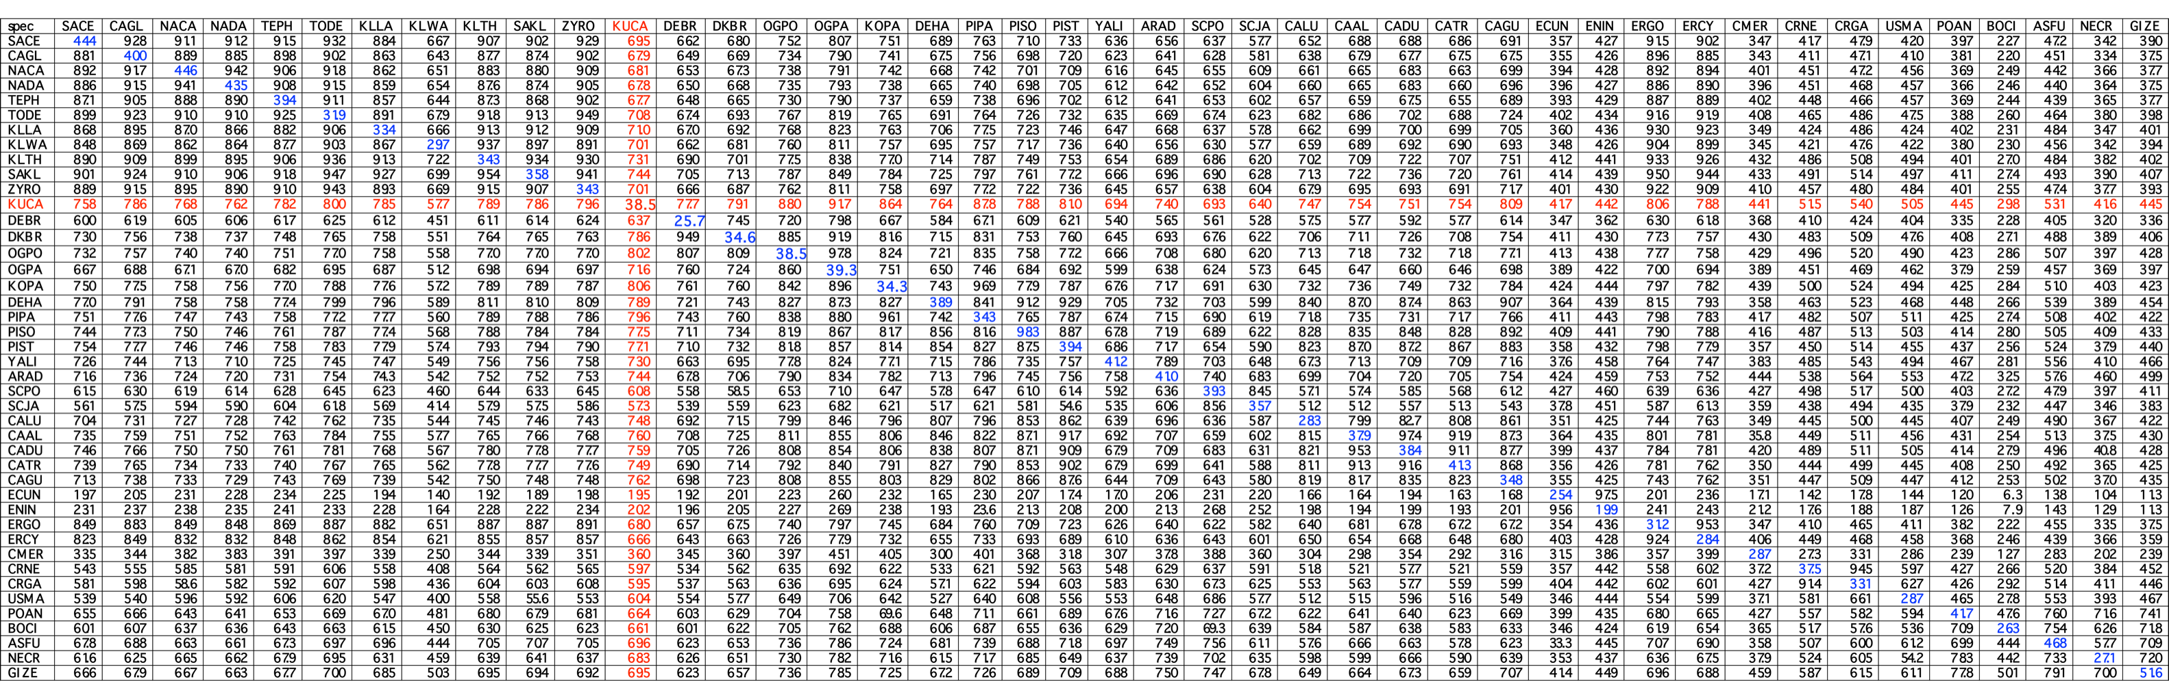
43 Yeast & Fungi species
98.3%
19.9%

Slide 62
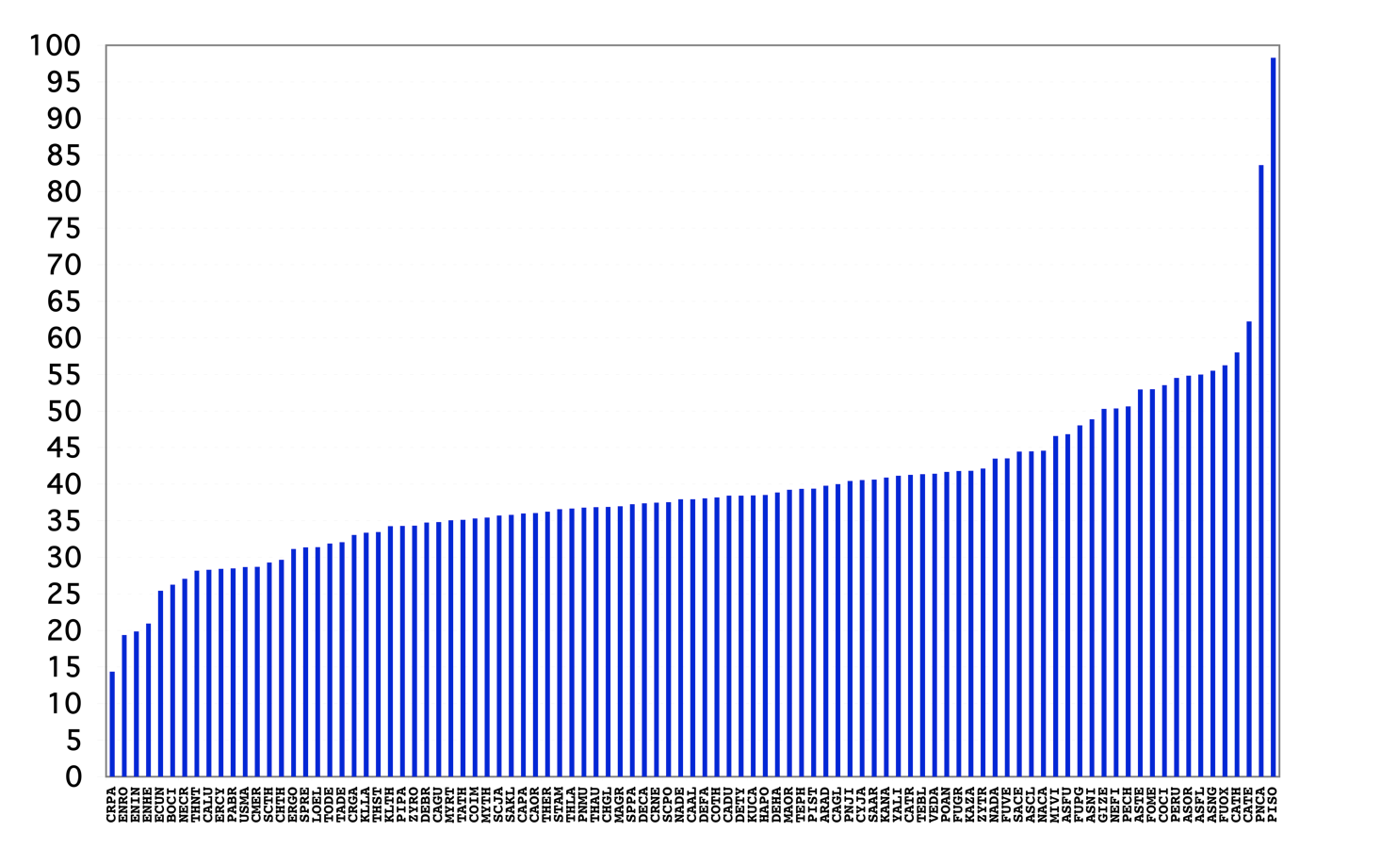
Rate of Duplication in 97 yeast and fungi species
Orfan (single) genes
Fredj Tekaia, unpublished

Slide 63
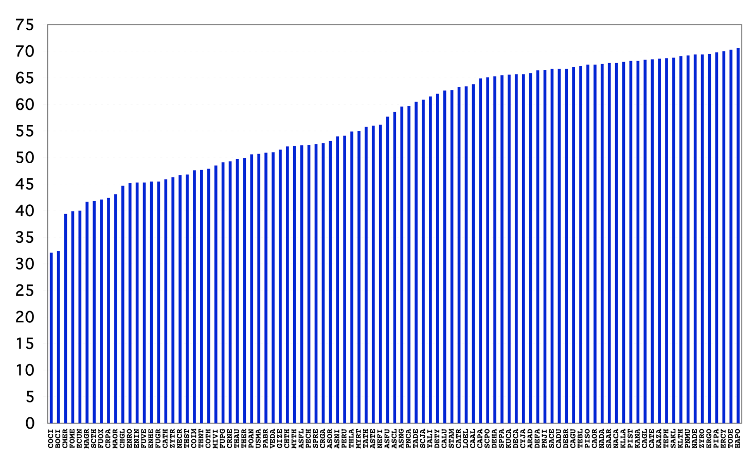
Rate of Conservation in 97 yeast and fungi species
Fredj Tekaia, unpublished

Slide 64
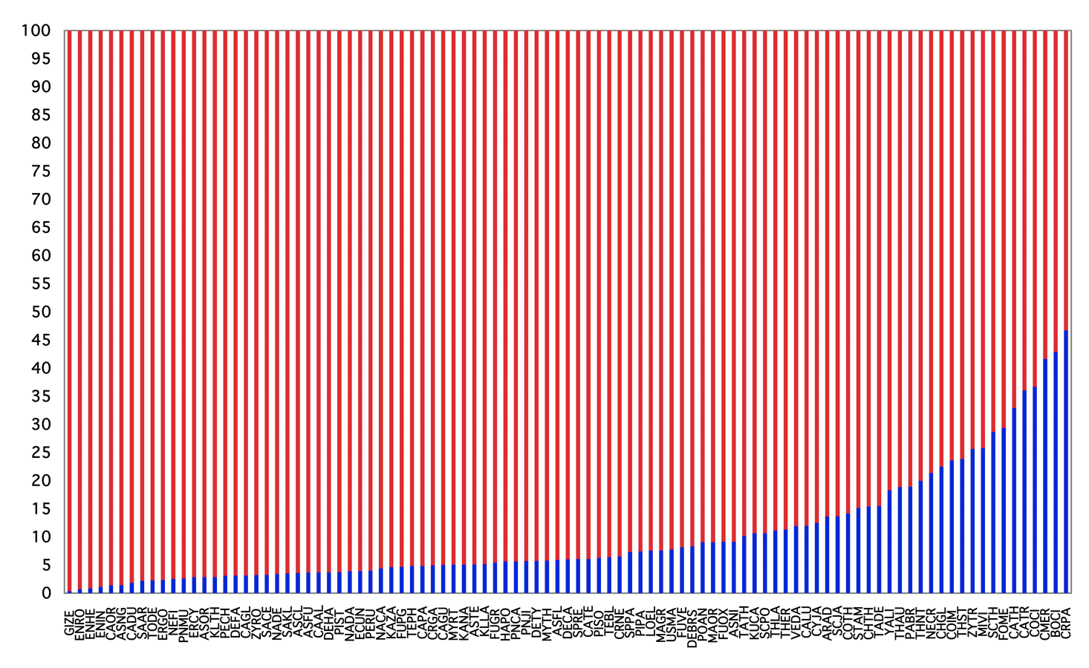
Specific and Nonspecific genes in 97 yeast and fungi species
Fredj Tekaia, unpublished

Slide 65
Species specific genes
100%
Specific members
conservation
0
different phylum
same phylum
genes

Slide 66
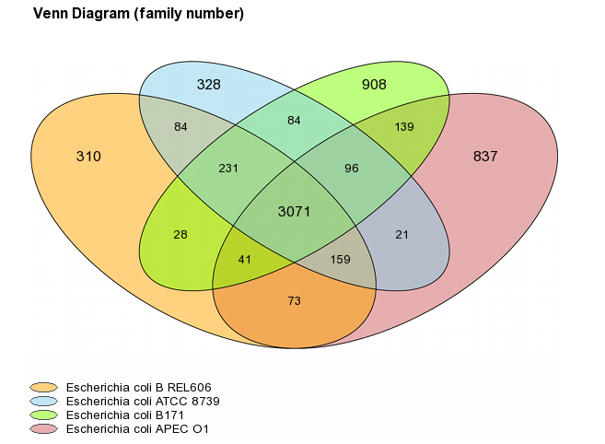
Pan-genome/Core-genome/Dispensable genome
• Pan-genome: The pan-genome is the entire gene set of all strains of a species. It includes genes present in all strains (core genome) and genes present only in some strains of a species (dispensable genome).
• Core-genome: The core genome is the set of genes present in all strains of a species.
• Dispensable genome/Accessory/variable/flexible: The dispensable genome refers to the set of genes present in at least one strain but not in all of them.

Slide 67
Example: Ratio core/pangenome of several bacterial species
Rouli et al. (2015). The bacterial pangenome as a new tool for analysing pathogenic bacteri. New Microbes New Infect. 2015;7:72-85.

Slide 68
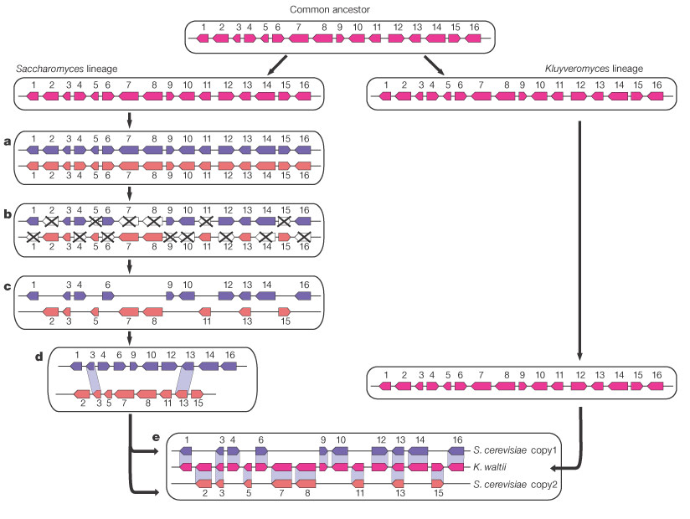
Duplication
Speciation
Deletion
Actual content of the 2 copies
Reconstruction of the ancestral organization
Kellis et al. 2004. Nature, 428:617-24.

Slide 69

Horizontal Gene Transfer (HGT)
Not all our genes are from our ancestors - some are “foreign”
http://www.medicalnewstoday.com/articles/290835.php

Slide 70
Horizontal Gene Transfer
• A fundamental concept in biology is that heritable material, DNA, is passed from parent to offspring, a process called vertical gene transfer.
• An alternative mechanism of gene acquisition is through horizontal gene transfer (HGT), which involves movement of genetic material between different species.

Slide 71
Horizontal Gene Transfer
Leads to different evolutionary histories of genes in species involved in HGT.
• HGT has emerged as a major evolutionary process that has shaped genomes.

Slide 72
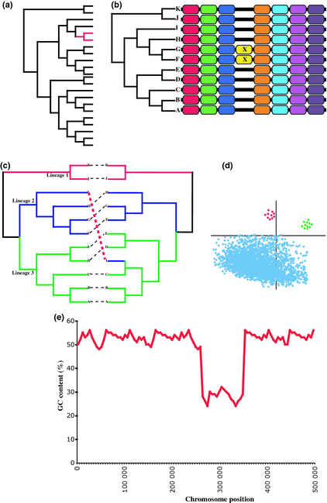
In silico detection of HGT
Fitzpatrick.DA. FEMS Microbiology Letters Volume 329, Issue 1, pages 1-8, 15 DEC 2011 DOI: 10.1111/j.1574-6968.2011.02465.x http://onlinelibrary.wiley.com/doi/10.1111/j.1574-6968.2011.02465.x/full#fml2465-fig-0001

Slide 73
HGT in Prokaryotes

Slide 74
Horizontal Gene Transfer
is an important mechanism of natural variation among prokaryotes.
Gene transfer has been identified as :
- a prevalent and pervasive phenomenon
- an important source of genomic innovation in bacteria.
• Estimates suggest that on average 81% of prokaryotic genes have been involved in HGT at some point of their history.
Dagan T, Artzy-Randrup Y, Martin W. (2008). Modular networks and cumulative impact of lateral transfer in prokaryote genome evolution. Proc Natl Acad Sci USA. 105:10039–44.

Slide 75
Horizontal Gene Transfer in Prokaryotes
Dagan T, Artzy-Randrup Y, Martin W. (2008). Modular networks and cumulative impact of lateral transfer in prokaryote genome evolution. Proc Natl Acad Sci USA. 105:10039–44.

Slide 76
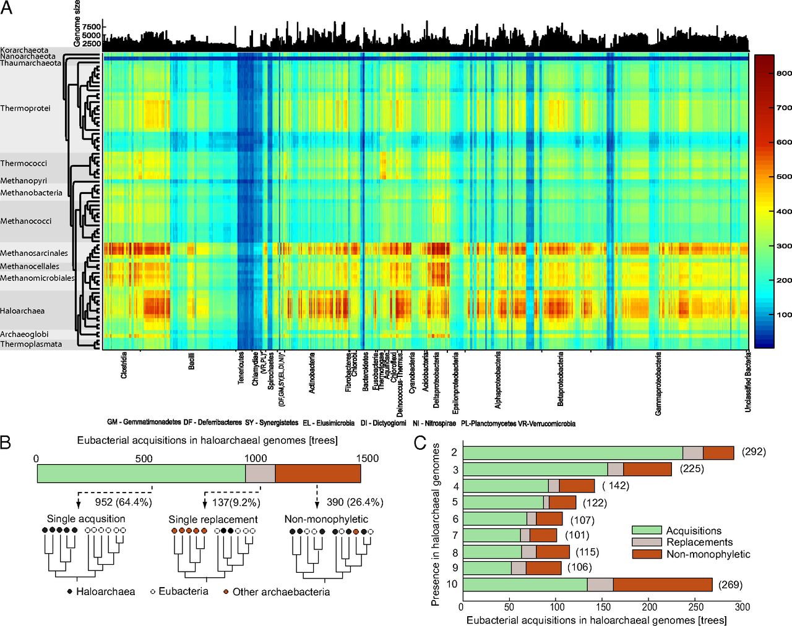
Acquisition of 1,089 eubacterial genes physiologically transformed a methanogen at the origin of Haloarchaea
(A) Number of shared genes between 1,078 bacterial genomes and 75 archaebacterial genomes.
Nelson-Sathi S et al. PNAS 2012;109:20537-20542

Slide 77
HGT in Eukaryotes

Slide 78
HGT in vertebrate and invertebrate genomes
• Considering 26 animal species (10 primates, 12 flies and 4 nematodes) and a further 14 vertebrates.
A Genome-wide comparative and phylogenetic analyses show that HGT in animals typically gives rise to hundreds of active "foreign" genes, largely concerned with metabolism.
• Evidence of HGT in humans is confirmed
Crisp A, Boschetti C, Perry M, Tunnacliffe A, Micklem G. (2015). Expression of multiple horizontally acquired genes is a hallmark of both vertebrate and invertebrate genomes. Genome Biol.16:50.

Slide 79
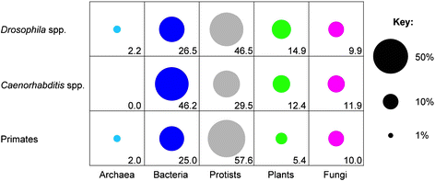
HGT in vertebrate and invertebrate genomes
The most common donors were Bacteria and Protists
Other genes came from fungi and viruses.
Crisp A, Boschetti C, Perry M, Tunnacliffe A, Micklem G. (2015). Expression of multiple horizontally acquired genes is a hallmark of both vertebrate and invertebrate genomes. Genome Biol.16:50.

Slide 80
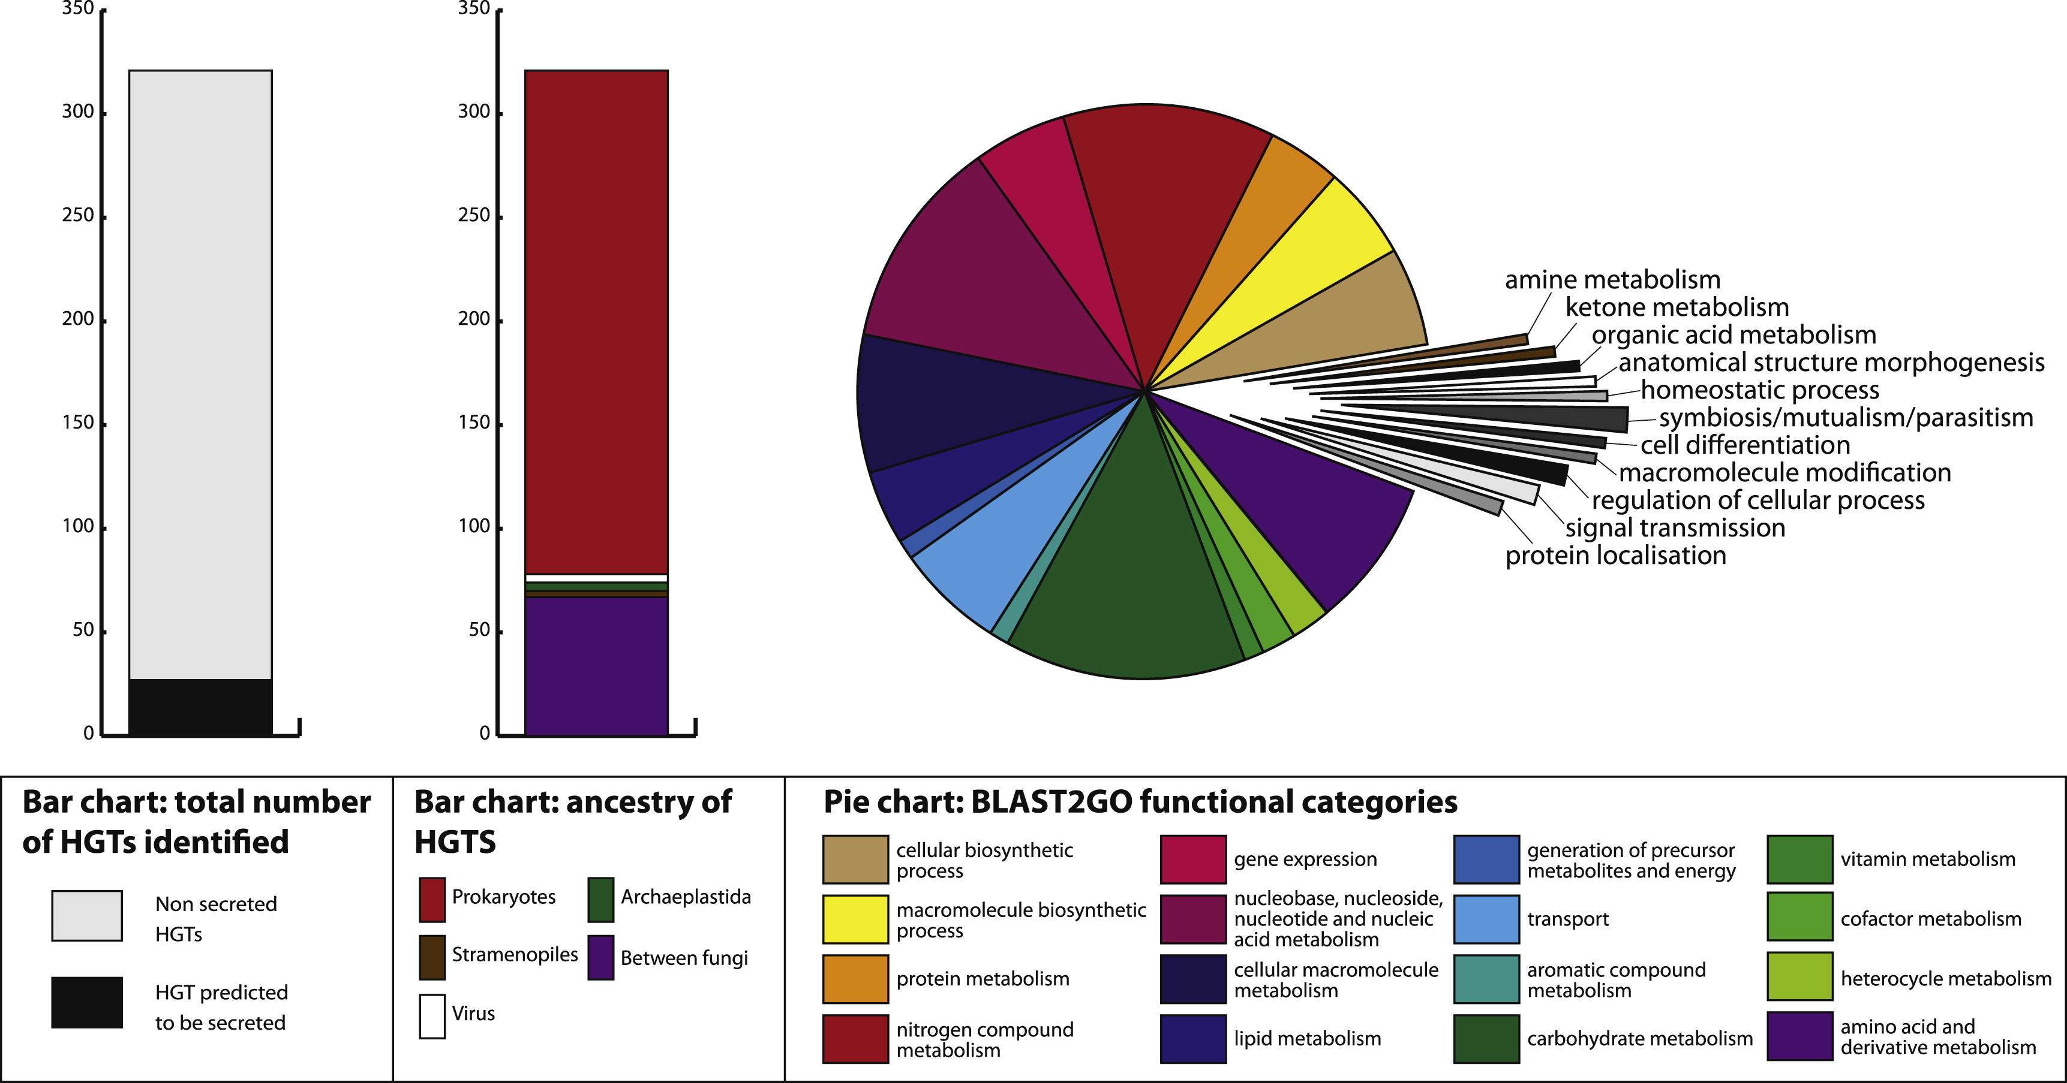
Ancestry of Horizontal Gene Transfer in Fungi
323 transfers into the fungi
Prokaryotes
Between fungi
Richards TA et al. (2011). Fungal Biology Reviews Volume 25, Issue 2 2011 98 - 110

Slide 81
HGT databases
• HGTree in prokaryotes: http://hgtree.snu.ac.kr
Jeong H, et al. (2016). HGTree: database of horizontally transferred genes determined by tree reconciliation. Nucl. Acids Res. 2016 44: D610-D619 http://nar.oxfordjournals.org/content/44/D1/D610.abstract?etoc

Slide 82
Orthologs Inference:
Context, Methods and Limitations
Tekaia F. Inferring Orthologs: Open Questions and Perspectives (Review). Genomics Insights 2016:9 17–28 doi:10.4137/GEI.S37925.

Slide 83
Ancestral conservation
• Inferring Orthologs between pairs of species
• Determining clusters of orthologs between multiple species
• Determination of protein conservation profiles.

Slide 84
Definitions
• Orthologs are homologous genes resulting from a speciation event
(Fitch, 1970)
• Paralogs are homologous genes resulting from a duplication event
Fitch WM. Homology a personal view on some of the problems.
Trends Genet. 2000;16:227-31. Review.

Slide 85
G
Orthologs - Paralogs
S
Duplication
Homologs: genes sharing a common origin.
Time
G1
G2
Speciation
Orthologs: genes in distinct species, originating from a single ancestral gene in the Last Commun Ancestor of the compared genomes.
Duplication
A-G1
A-G2
B-G1
B-G2₁
B-G2₂
outparalogs
Paralogs: genes related via duplication.
outparalogs
inparalogs
A
orthologs
B
Koonin EV. 2005. Annu Rev Genet. 39:309-38.
Tekaia F. 2016. Inferring Orthologs: Open questions and perspectives. Genome Insights. 9: 17-28.
Predict these events by comparing genomes?
Notes:
Homologs: g

Slide 86
Inferring Orthologs/Paralogs and classification
Orthologs detection is of fundamental importance in:
Reconstruction of the evolution of species and their genomes (Phylogenomics);
- Evolutionary studies of biological systems;
- Annotation of newly sequenced organisms;
- Functional genomics (transfer of functional annotation);
- Gene organization in a given species.

Slide 87
Orthologs / Paralogs
Complex combinations of lineage-specific gene duplications, losses, domains fusion, and horizontal gene transfer events often give rise to intricate evolutionary scenarios and complicated relationships when considering more than a pair of genomes.
Koonin EV. 2005. Annu Rev Genet. 39:309-38.
Gabaldon T, Koonin EV. 2013. Nat Rev Genet. 14:360-6.

Slide 88
Difficulties with Orthology inference:
• HGT: genes with different evolutionary histories not sharing ancestry with other genes in the species
• Proteins with multiple domains involving multiple origins (difficulty with the homology definition)
(Fusion, fission, shuffling)
Tekaia F. Inferring Orthologs: Open Questions and Perspectives (Review). Genomics Insights 2016:9 17–28 doi:10.4137/GEI.S37925.

Slide 89
Loss of genes : Example of an orthology misleading situation
g₀
g_{1a}
g_{1b}
g_{2a}
g_{2b}
g₃
X
X
g
g₀
g₁
g₂
g₃
S₂
g₀
g₁
g₂
g₃
X
S
S
S₁
Gd
Sp + Gd in S₂
We assume that gene g₁ (in S₁) and genes g_{2a} and g_{2b} (in S₂) are lost, similarity and phylogenetic methods for orthology detection will assign erroneously orthology to g₂, g_{1a} and g_{1b}. Indeed these are not orthologous, because g₂, g_{1a} and g_{1b} do not result from the same ancestral gene after the speciation event.
In this case solely the environment conservation, will help in detecting the gene duplication end loss event, and hypothesise their non-orthology.

Slide 90
In spite of the above mentioned difficulties, genome-wide statistical trends show that orthologs are the most similar genes in different species, in terms of sequence, structure and function.

Slide 91
Methods for orthology detection
Two main approaches to determine orthologous gene classes, based either on:
• Sequence similarity
or on
• Phylogeny

Slide 92
Similarity based Approaches
• Rely on genome comparisons and clustering of highly similar genes to identify orthologous groups

Slide 93
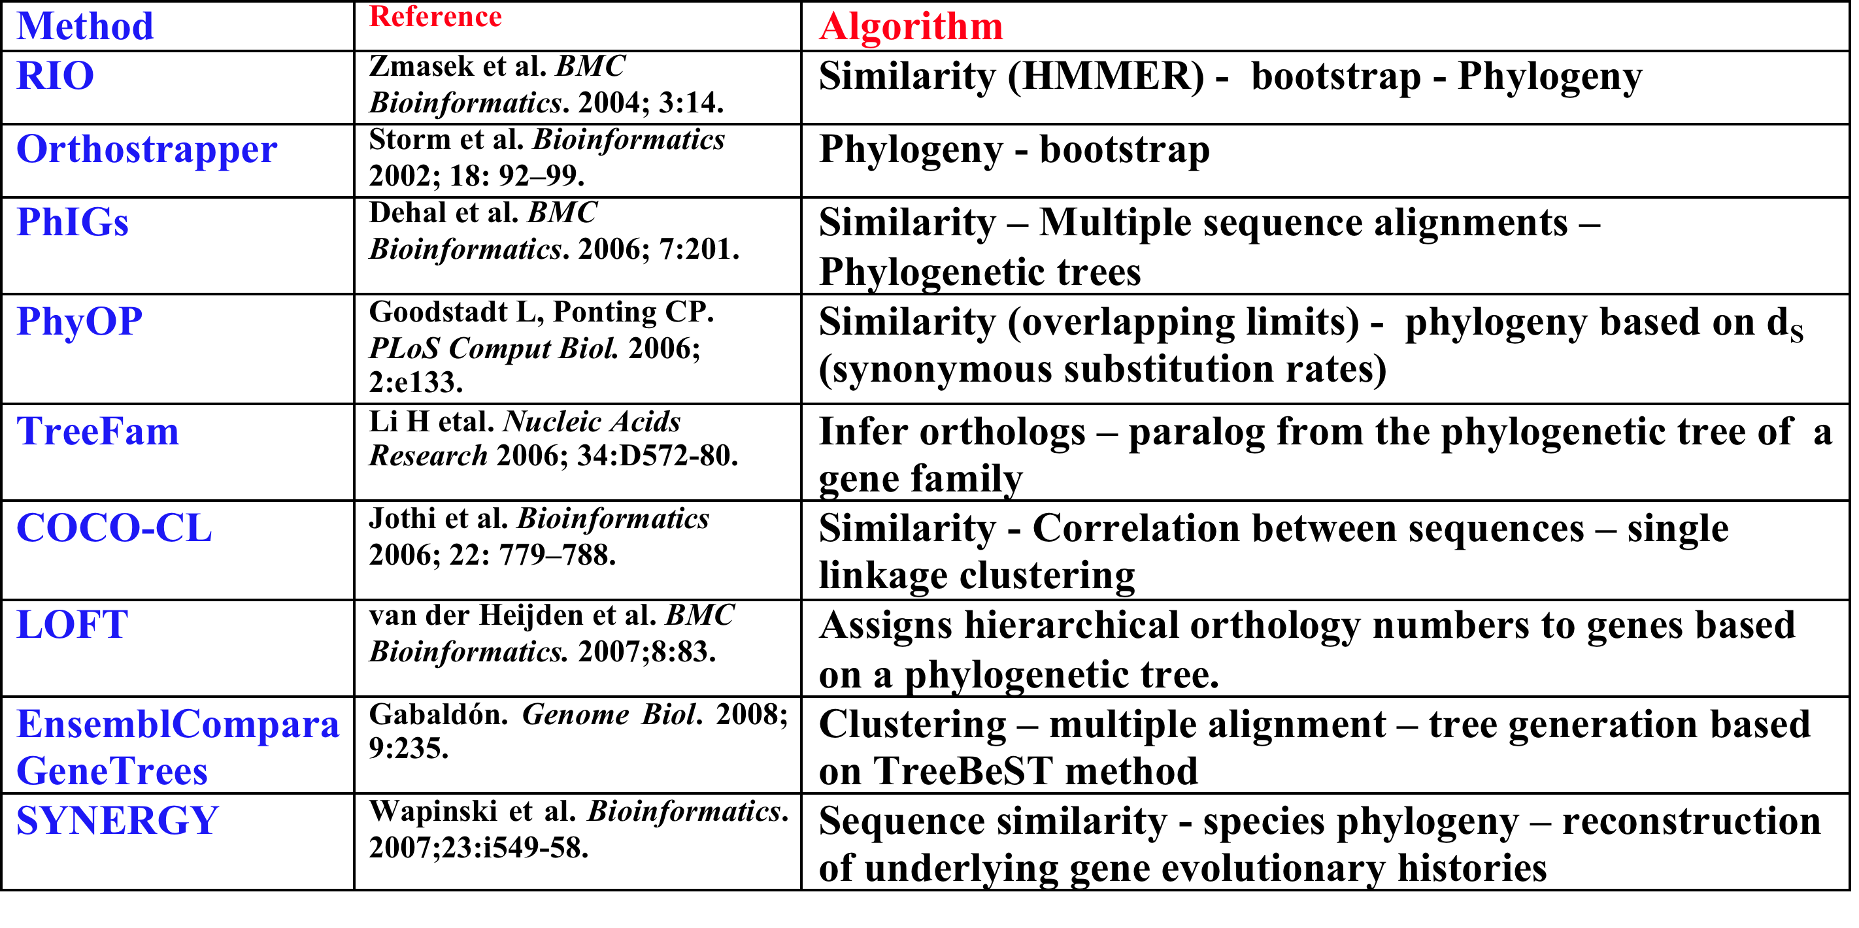
Phylogeny-based approaches
use candidate gene families determined by similarity and rely on the reconciliation of the phylogeny of these genes with their corresponding species phylogeny to determine the subset of orthologs

Slide 94
• Phylogeny based methods fit best for small sets of genomes
• Similarity based methods fit best for large genome-data sets

Slide 95
Inferring Orthologs / Paralogs and classification is a complex task
• COG, KOG: Tatusov RL, et al. (2000)
• TribeMCL: Enright AJ, Kunin V, Ouzounis CA. (2003)
• OrthoMCL: Li L, Stoeckert CJ Jr, Roos DS. (2003)
• OMA: Dessimoz,C., et al. (2005) ; Schneider A, et al. (2007)
• Koonin EV. 2005. Orthologs, paralogs, and evolutionary genomics. Annu Rev Genet. 39:309-38. Review.
• Chen F, Mackey AJ, Vermunt JK, Roos DS (2007). Assessing performance of orthology detection strategies applied to eukaryotic genomes. PLoS ONE. 2:e383.
• Kuzniar A, van Ham RC, Pongor S, Leunissen JA. (2008). The quest for orthologs: finding the corresponding gene across genomes.Trends Genet. 24(11):539-51. Review.

Slide 96
Othology Databases
• COGs (Clusters of Orthologous Groups): http://www.ncbi.nlm.nih.gov/COG/
• eggNOG (evolutionary genealogy of genes: Non-supervised Orthologous Groups): http://eggnog.embl.de/version_3.0/
• OMA (Orthologous Matrix): http://omabrowser.org/cgi-bin/gateway.pl
• OrthoMCL: http://orthomcl.org/orthomcl/
http://questfororthologs.org/orthology_databases

Slide 97
SPO Conservation Profile
In 8 Aspergilli species
SPO8.1 ASFL-ASOR-ASTE-ASNG-NEFI-ASFU-ASCL-ASNI
SPO8.1 1 1 1 1 1 1 1 1
SPO4.2 ....-ASOR-....-ASNG-NEFI-ASFU-....-....
SPO4.2 0 1 0 1 1 1 0 0
SPO15.3 ASFL-ASOR-ASTE-....-NEFI-ASFU-ASCL-ASNI
SPO15.3 1 1 1 0 4 3 3 2
Tekaia F & Yeramian E (2012).Superpartitions: Detection and classification of orthologs. Gene; 492:199-211.

Slide 98
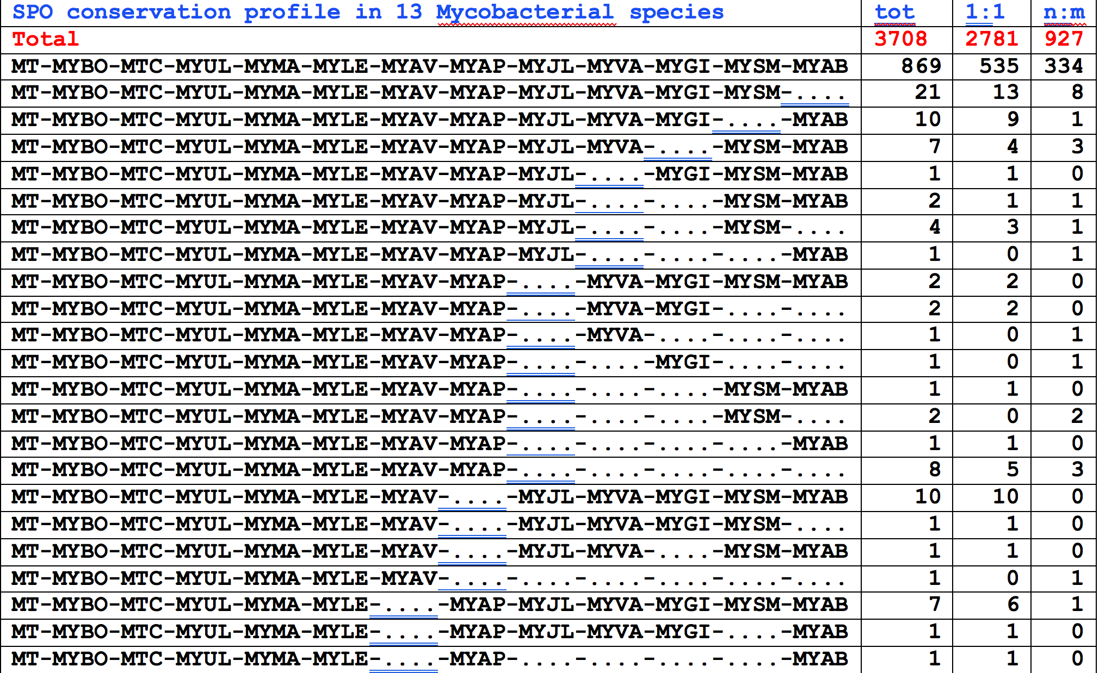

Slide 99
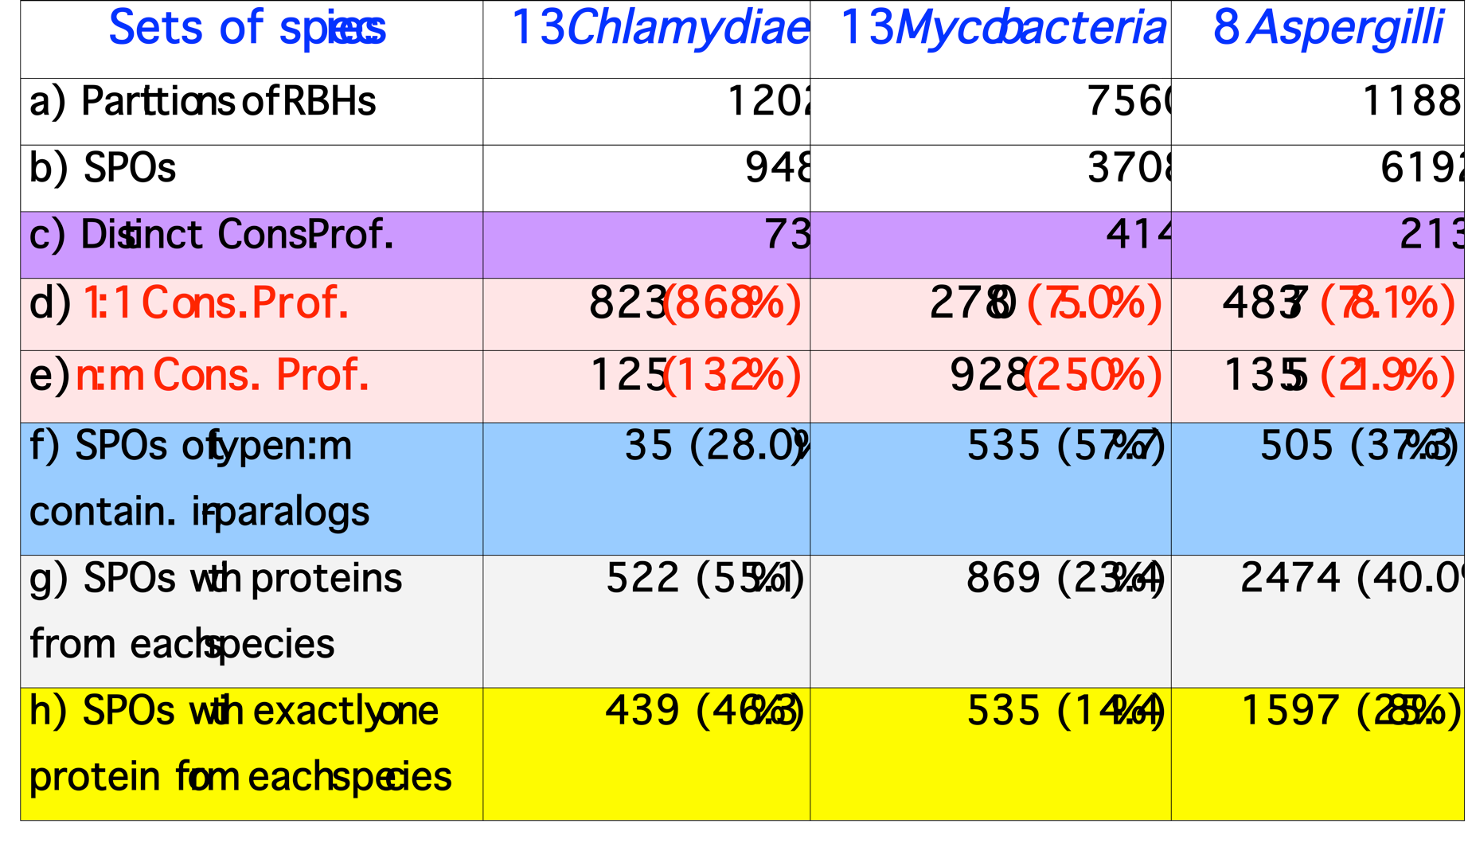
SPOs Conservation Profiles

Slide 100
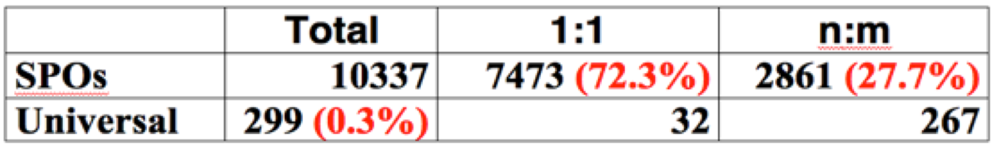
SPO conservation profiles in Yeast & fungi

Slide 101
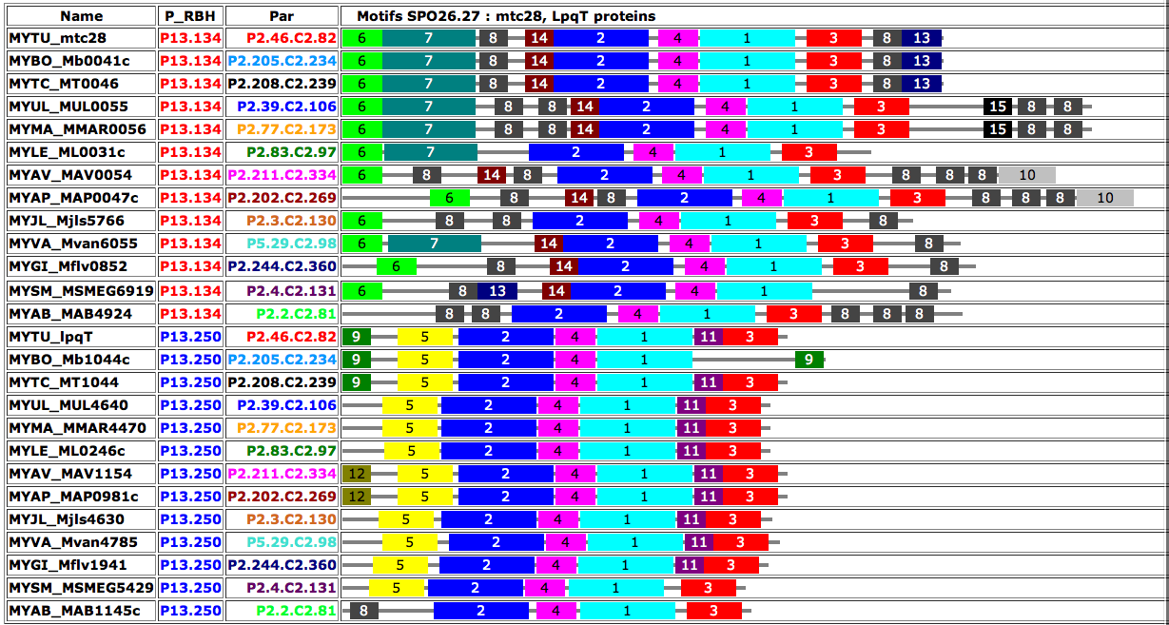

Slide 102
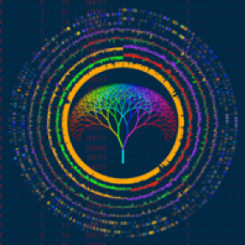
Genome Trees - Phylogenomics

Slide 103
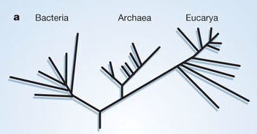
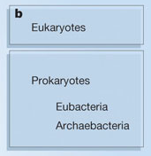
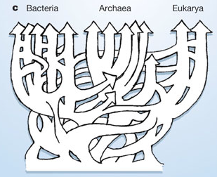
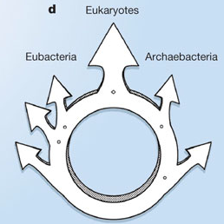
Martin & Embley
Nature 431:152-5.(2004)
The two-empire proposal, separating eukaryotes from prokaryotes and eubacteria from archaebacteria. Mayr, D. PNAS 95:9720-23. (1998).
The three-domain proposal based on the ribosomal RNA tree. Woese et al. PNAS. 87:4576-4579. (1990)
The ring of life, incorporating lateral gene transfer but preserving the prokaryote eukaryote divide.
Rivera & Lake JA. Nature 431: 152-5. (2004)
The three-domain proposal, with continuous lateral gene transfer among domains.
Doolittle. Science 284:2124-8. (1999)

Slide 104
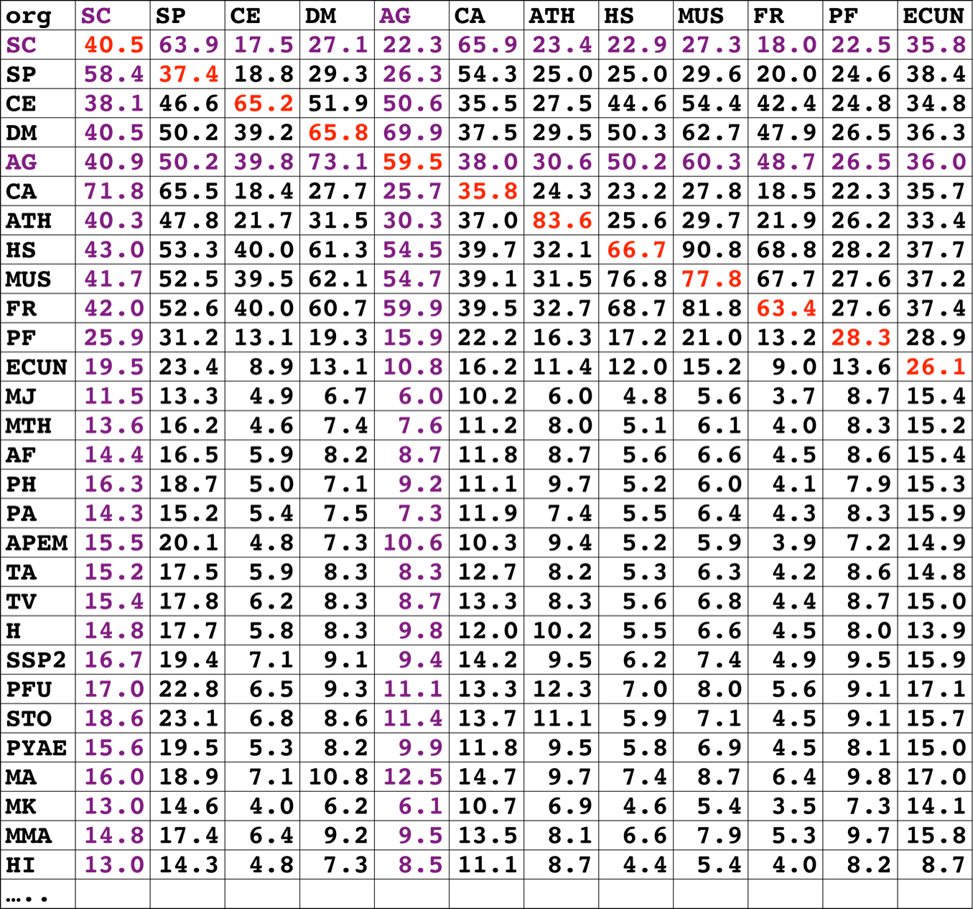
Ancestral duplication and ancestral conservation
W_{ij}
• genome similarity
• shared orthologs

Slide 105
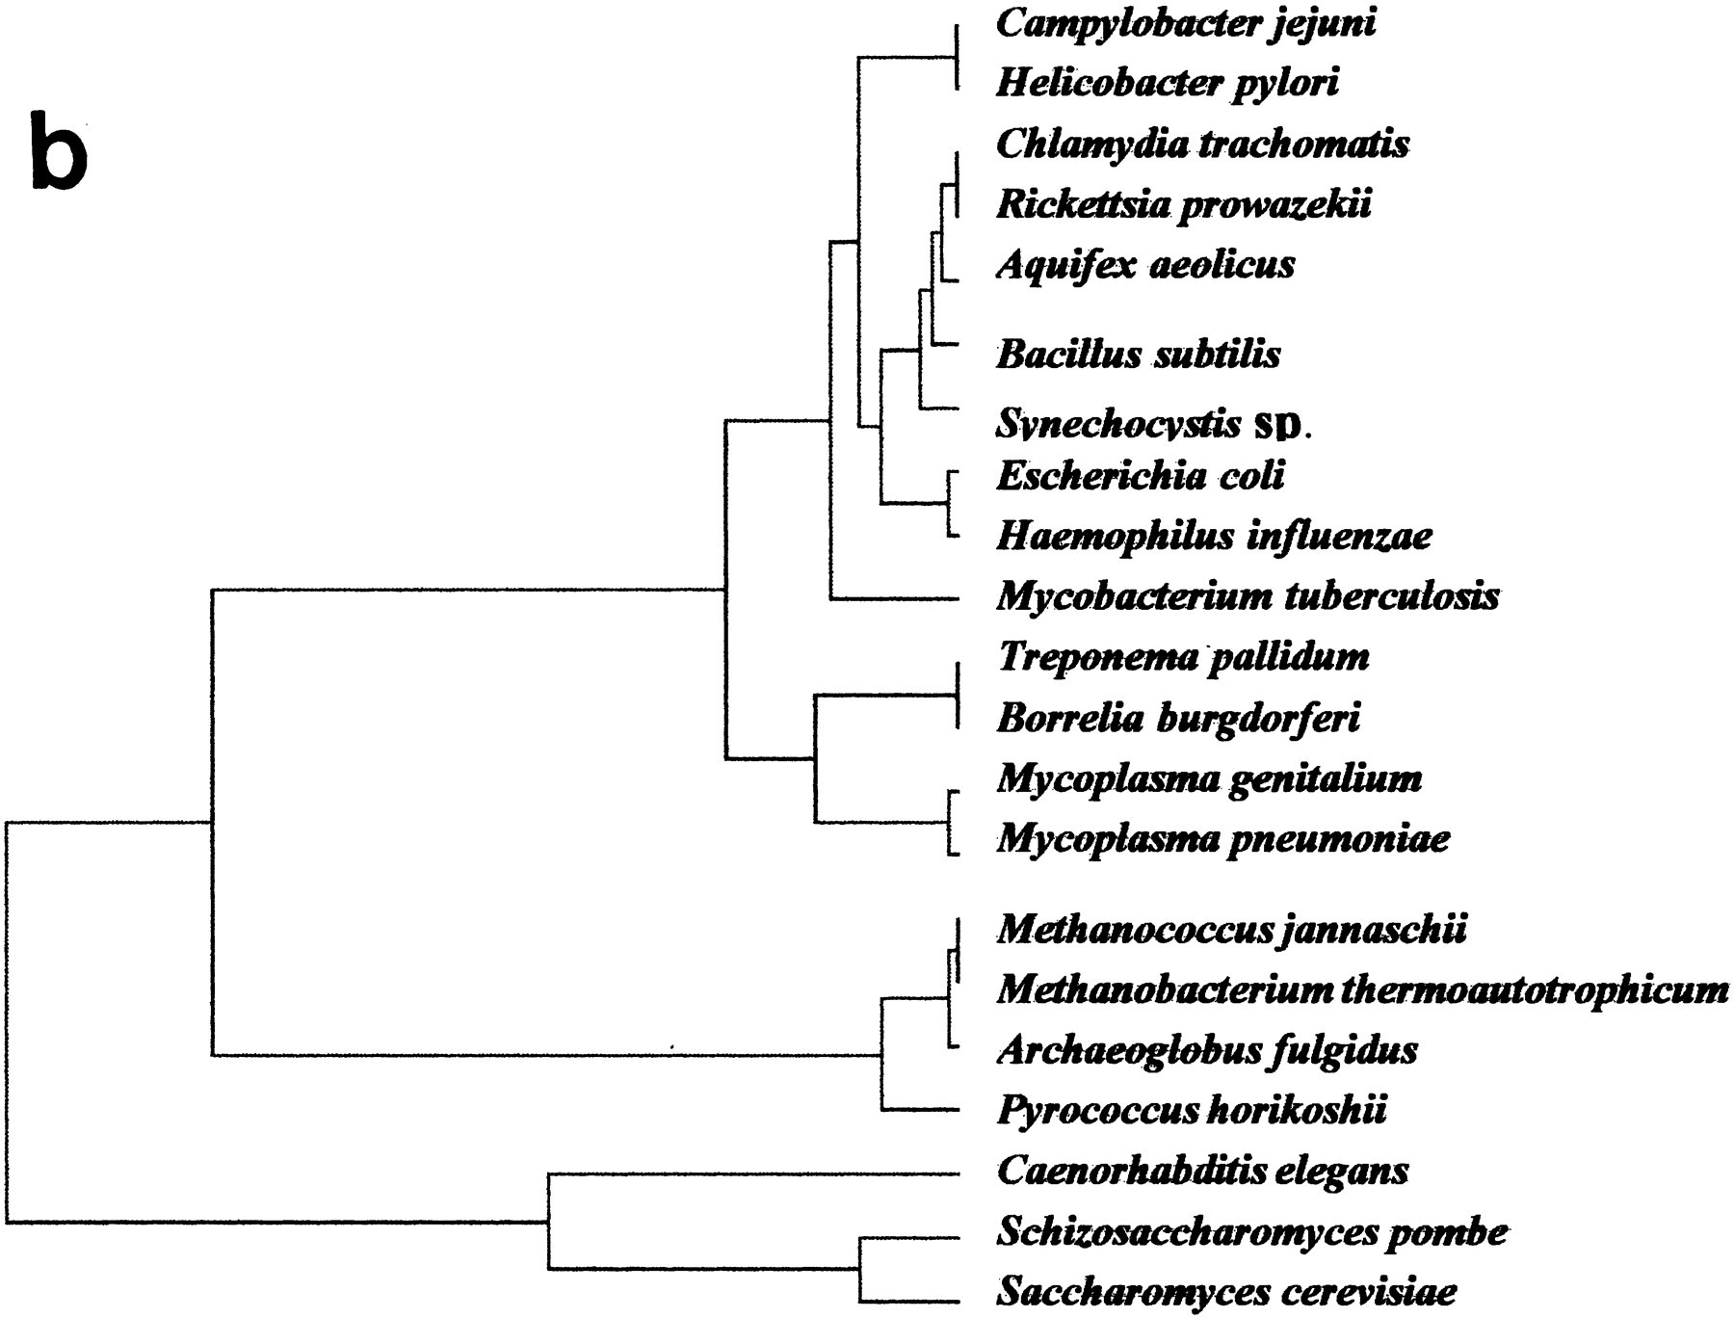
Tekaia, Lazcano & Dujon (1999)
Genome Research 9: 550-7.
B
A
E

Slide 106
Conservation profiles
• 99 species (B: 33; A: 19; E:27); 541880 proteins
p 0111111000111111111000110110111101001111101111
• A “conservation profile” is an n-component binary vector describing a protein conservation pattern across n species.
Components are 0 and 1, following absence or presence of homologs.
Main interesting properties of conservation profiles:
• Conservation profiles are signatures of evolutionary relationships;
• A conservation profile is the trace of protein evolutionary histories jointly captured in a set of n species (multidimensional feature);
Tekaia F, Yeramian E. (2005). PLoS Comput Biol.1(7):e75

Slide 107
Protein conservation profiles
E A B
S₁..............I.............I................S_{n}
G_{1,1} 100000000000000000000000000000000000000000000000
G_{2,1} 111111111111111111111111111111111111111111111111
G_{3,1} 111111110011111111111111011101110101111111101111
.......................................................
G_{n1,1} 100001110001000000000000000000000000000000000000
G_{1,2} 010000000000000000010100000000000111000011100011
G_{2,2} 010000000000000000010100000000000111000011100011
........................................................
G_{n2,2} 111111110011111111111111011101110101111111101111
........................................................
G_{1,n} 011110100000000000000000001000000000000000000001
G_{2,n} 111111110011111111100011011101110101111111101111
G_{3,n} 111111110011111111100011011101110101111111101111
........................................................
G_{np,n} 100110000000000000000000000000000000000000000001
Table : 541880 proteins x 99 species
• Different conservation profiles represent different evolutionary histories

Slide 108
Genome trees: data matrices
T = {T_{ij} ; i=1,n; j=1,n; n is the number of surveyed species}
T_{ij} is the overall similarity score between species j and i: conservation; shared orthologs,...
• Jaccard similarity scores
{ s_{ij} = N₁₁/(N₁₁+N₀₁+N₁₀); }
{s_{ij} = (Jaccard similarity score between species i and j) }
T = { T_{ij} = 100*s_{ij} ; i=1,n; j=1,n}
184130 distinct conservation profiles

Slide 109
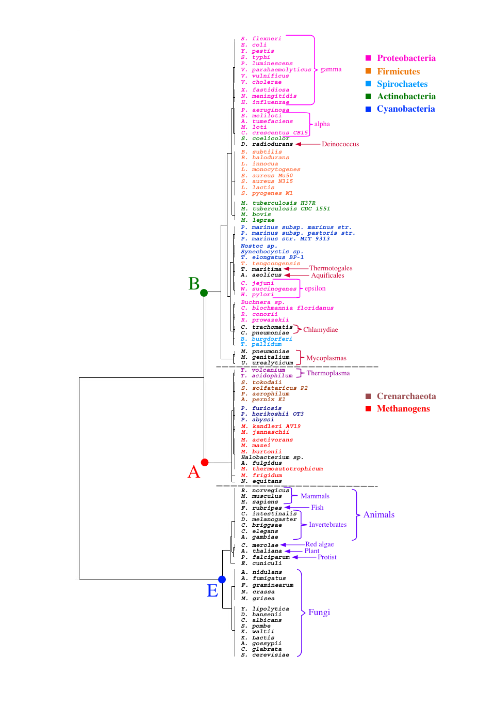
profiles tree
Tekaia F, Yeramian E. (2005).
PLoS Comput Biol.1(7):e75

Slide 110
• Phylogenomic tree
(based on concatenation of a gene sample common to the considered species)
S₁
.
.
S_{n}
Difficulties:
• genes don't evolve at the same rate nor in the same way;
• a limited number of genes are shared among all species;
Dagan and Martin (2006). The tree of one percent. Genome Biology, 7:118.

Slide 111
Whole genome alignments

Slide 112
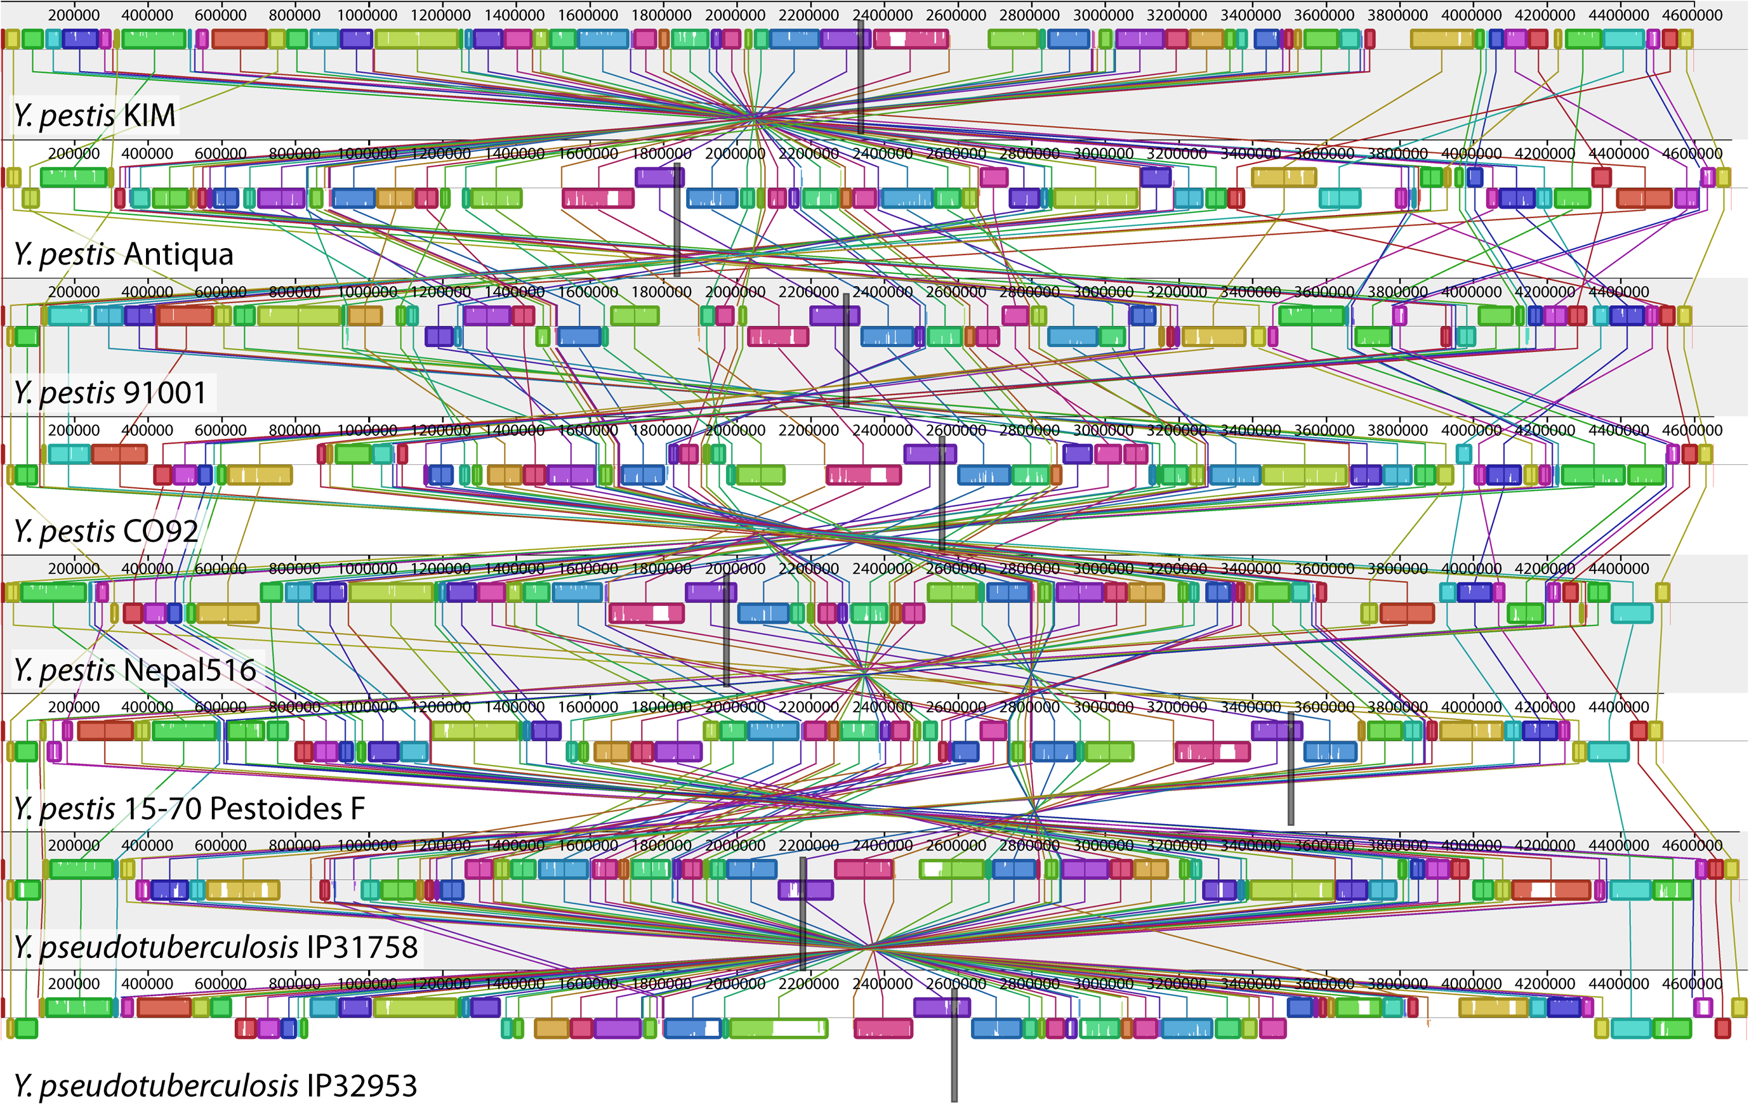
Multiple whole genome alignments
Aaron E. Darling, Istvan Miklos, Mark A. Ragan (2008). Dynamics of Genome Rearrangement in Bacterial Populations. PLoS Genet. 2008 July; 4(7): e1000128.

Slide 113
Whole Alignment of two genomes
Translocation
Inversion
Insertion
B
A
B
• Synteny detection
• Genomic Repeats detection
http://cbcb.umd.edu/.../Lecture10_MUMmer_alignment.ppt
A

Slide 114

Whole genome alignments
• MUMmer (Maximal Unique Matcher)
http://mummer.sourceforge.net/
http://gel.ahabs.wisc.edu/mauve/

Slide 115



Whole genome alignments
LAGAN
Multi-LAGAN
http://lagan.stanford.edu/lagan_web/index.shtml
Three main steps:
1.Generation of local alignments.
2. Construction of a rough global map.
3. Computation of the final global alignment.

Slide 116
Visualization tools

Slide 117

Genomic data visualization with CIRCOS
http://circos.ca/

Slide 118

http://circos.ca/guide/genomic/img/circos-conservation.png

Slide 119

Artemis: Genome Browser and Annotation Tool
http://www.sanger.ac.uk/resources/software/artemis/

Slide 120

Gbrowse
http://gmod.org/wiki/Gbrowse

Slide 121
Next-generation sequencing technologies

Slide 122
Next-generation sequencing technologies
Have allowed a massive increase in available raw sequence data
Implying a number of new informatics, computational challenges and difficulties.
• List of Bioinformatics Tools for NGS:
http://bioinformaticsonline.com/pages/view/26617/list-of-bioinformatics-software-tools-for-next-generation-sequencing
Curr Opin Biotechnol. 2012 Feb;23(1):9-15. doi: 10.1016/j.copbio.2011.11.013. Epub 2011 Dec 9.Next generation sequencing and bioinformatic bottlenecks: the current state of metagenomic data analysis.Scholz MB, Lo CC, Chain PS.

Slide 123


Improvements in the rate of DNA
sequencing over the past 30 years and into the future
MR Stratton et al. Nature 458, 719-724 (2009) doi:10.1038/nature07943

Slide 124
A variety of applications:
• Genomes: de novo or re-sequencing;
• Transcriptome sequencing (RNA-Seq);
• Cancer genomics;
• Human genetic variation analyses:
-Single Nucleotide Polymorphism (SNP), - Small Insertion/Deletion (Indels), Structural variations (SV), large structural variants;
• Disease-targeted sequencing;
• Ancient genome;
• Metagenomics;
• Epidemiology;
• Clinical applications (therapeutic decisions);…
*****Papers on Application of Next-Generation Sequencing: http://www.nature.com/nrg/series/nextgeneration/index.html ******

Slide 125

Genomic Variation
Sequence versus Structural Variation
http://www.ensembl.org/info/genome/variation/

Slide 126
Genomic Variation
Includes:
• Single nucleotide variants
• Large structural variants
Notes:
Multiple display resolutions for NGS data in GBrowse 2.0. The ‘Overview’ panel shows NGS coverage as a histogram. Below this, in the ‘Region’ panel, is an example showing individual reads, while the ‘Details’ view shows a zoomed-in view of the base pairs. Places where the read sequence differs from the reference sequence are highlighted.

Slide 127

Sequence variants:
Notes:
Basic workflow for whole-exome and whole-genome sequencing projects. After library preparation, samples are sequenced on a certain platform. The next steps are quality assessment and read alignment against a reference genome, followed by variant identification. Detected mutations are then annotated to infer the biological relevance and results can be displayed using dedicated tools. The found mutations can further be prioritized and filtered, followed by validation of the generated results in the lab.

Slide 128




Structural variants (>= 50 bases):
• The full list of variants in Ensembl can be found at this link:
http://www.ensembl.org/info/genome/variation/data_description.html#classes

Slide 129

Four main methods for detecting CNVs with NGS data
Pirooznia M, Goes FS, Zandi PP (2015). Front Genetic. 6:138.

Slide 130
• It is estimated that about 12% of the genome in human populations is subject to copy number change.
• So far, approximately half of the reported CNVs overlap with protein regions.
• CNVs and SNVs do not necessarily have a negative effect on human health. However, among the large number of CNVs, some might have an association with, or directly involved in diseases and phenotype such as cancer and neuropsychiatric disorders.
Redon R et al. Global variation in copy number in the human genome. Nature 2006; 444:444-454.
Sebat J et al. Large-scale copy number polymorphism in the human genome. Science 2004, 305:525-528.

Slide 131

2015
1000 Genomes Project
1 October
An integrated map of structural variation in 2504 human genomes from 26 global populations
Revealed:
• 84.7 million single-nucletide variants (SNVs);
• 3.6 million insertion/deletion (indels) variants;
• more than 60000 structural variants (SVs) (ie based on event size >= 15bp )
Sudmant et al. Nature 526, 75-81 (01 October 2015) doi:10.1038/nature15394

Slide 132
Resources for mining variants:
See also: Databases of genomic variation and phenotypes: existing resources and future needs.Johnston JJ, Biesecker LG.Hum Mol Genet. 2013;22(R1):R27-31. Review.

Slide 133
Resources for mining Variants
Cancer:
Plants:
• 1001genomes.org (A. thaliana)
• www.onekp.org (1000 plants genomes)

Slide 134


Mutational signatures associated with tobacco smoking
Ludmil B. Alexandrov et al. Science 2016;354:618-622
Published by AAAS
Notes:
Mutational signatures associated with tobacco smoking. (A) Each panel contains 25 randomly selected cancer genomes (represented by individual bars) from either smokers or nonsmokers in a given cancer type. The y axes reflect numbers of somatic mutations per megabase. Each bar is colored proportionately to the number of mutations per megabase attributed to the mutational signatures found in that sample. The naming of mutational signatures is consistent with previous reports (16–18). (B) Each panel contains the pattern of a mutational signature associated with tobacco smoking. Signatures are depicted using a 96-substitution classification defined by the substitution type and sequence context immediately 5′ and 3′ to the mutated base. Different colors are used to display the various types of substitutions. The percentages of mutations attributed to specific substitution types are on the y axes, whereas the x axes display different types of substitutions. Mutational signatures are depicted based on the trinucleotide frequency of the whole human genome. Signatures 2, 4, 5, 13, and 16 are extracted from cancers associated with tobacco smoking. The signature of benzo[a]pyrene is based on in vitro experimental data (19). Numerical values for these mutational signatures are provided in table S6.

Slide 135

More reasons to quit
Gerd P. Pfeifer Science 2016;354:549-550
Published by AAAS
Notes:
More reasons to quit Enrichment of a specifc mutational signature in cancers of smokers is strongly linked to the odds ratio of developing cancer.

Slide 136
Metagenomics
From samples (human, sea, polluted area, soils,… ):
• Who is there and abundance
• What are their functions
(what strains and what genes are present)
• Is it possible to recover genomes
• Are there novel pathogenic organisms

Slide 137

Human Microbiome
Grice EA and Segre JA.(2012). The Human Microbiome: Our Second Genome. Annual Review Hum. Genet. 13:151-70.

Slide 138

Microbes and Microbiome
The Ratio of Bacteria to Human Cells in the Adult Body Revised
With the revised estimates for the number of human (3.0.10¹³) and bacterial cells (3.8.10¹³) in the body, we can give an updated estimate of B/H=1.3, with an uncertainty of 25% and a variation of 53% over the population of standard 70 kg males.
This B/H value of about 1:1 (with the associated uncertainty range) should replace the 10:1 or 100:1 values that are stated in the literature until more accurate measurements become available.
Sender R, Fuchs S, Milo R (2016) Revised Estimates for the Number of Human and Bacteria Cells in the Body. PLoS Biol 14(8): e1002533

Slide 139


Gut Microbiota in Human Adults with Type 2 Diabetes Differs from Non-Diabetic Adults
• non-diabetic
• type 2 diabetes
Relative abundances of bacterial phyla and classes.
Larsen N, Vogensen FK, van den Berg FWJ, Nielsen DS, Andreasen AS, et al. (2010). PLOS ONE 5(2): e9085. doi:10.1371/journal.pone.0009085
http://journals.plos.org/plosone/article?id=10.1371/journal.pone.0009085
Notes:
Figure 2. Relative abundances of bacterial phyla and classes.
Relative abundances (%) of bacteria were determined in feces from human adults with type 2 diabetes (green triangles, N = 10) and non-diabetic controls (blue dots, N = 10) by pyrosequencing analysis of the V4 region of the 16S rRNA gene. Mean values are denoted by red crosses and numbers. Values out of scale are shown in brackets.

Slide 140

Schematic overview of the Human Pathology Atlas
Mathias Uhlen et al. Science 2017;357:eaan2507
All data are available at this site:
www.proteinatlas.org/pathology
Notes:
Schematic overview of the Human Pathology Atlas. A systems-level approach enables analysis of the protein-coding genes of 17 different cancer types from ~8000 patients. Results are available in an interactive open-access database.

Slide 141
• Ecogenomics and potential biogeochemical impacts of globally abundant ocean viruses
Complete genomes and large genomic fragments from both surface and deep-ocean viruses sampled by the Tara Oceans and Malaspina research expeditions were assembled and analysed by the “global ocean virome” dataset to present a global map of abundant dsDNA viruses.
A total of 15222 epipelagic and mesopelagic viral populations were identified. This roughly triples the number of known ocean viral populations and doubles the number of candidate bacterial and archaeal virus genera.
Roux S et al. Tara Oceans Coordinators (2016). Ecogenomics and potential biogeochemical impacts of globally abundant ocean viruses..Nature. 2016 Sep 21. doi: 10.1038/nature19366.

Slide 142
A human gut microbial gene catalogue established by metagenomic sequencing
Metagenomic sequencing, assembly and characterization of 3.3 million non-redundant microbial genes, derived from 576.7 gigabases of sequence, from faecal samples of 124 European individuals.
The gene set, c.a 150 times larger than the human gene complement, contains an overwhelming majority of the prevalent microbial genes of the cohort and probably includes a large proportion of the prevalent human intestinal microbial genes.
Over 99% of the genes are bacterial, indicating that the entire cohort harbours between 1,000 and 1,150 prevalent bacterial species and each individual at least 160 such species, which are also largely shared.
The minimal gut metagenome and the minimal gut bacterial genome in terms of functions present in all individuals and most bacteria, are respectively defined and described.
Qin J et al. (2016). Nature 4: 59-67.

Slide 143
The impact of whole-genome sequencing on the reconstruction of human population history
Krishna R. Veeramah & Michael F. Hammer (2014). The impact of whole-genome sequencing on the reconstruction of human population history. Nature Reviews Genetics 15, 149-162 (2014)

Slide 144
Synthetic Biology

Slide 145
Synthetic Biology
Designing and building genomes
A core theme in synthetic biology, “understanding by creating”, inspired the efforts to generate synthetic cell.
https://www.nature.com/nature/focus/synbio/index.html
http://syntheticyeast.org
Genome Project-write: GP-write
Kannan K and Gibson DG. 2017. Yeast genome, by design. Science, 2017;35pp.1024-1025.

Slide 146

2016
Synthetic Biology
Designing and building a minimal bacterial genome
Three cycles of design, synthesis, and testing, with retention of quasi-essential genes, produced JCVI-syn3.0 (531 kilobase pairs, 473 genes), which has a genome smaller than that of any autonomously replicating cell found in nature.
Hutchison CA 3rd, et al.Science. 2016 Mar 25;351(6280). Design and synthesis of a minimal bacterial genome.

Slide 147
Synthetic microbe has fewest genes, but many mysteries. Robert F. Service
2016
Meet Syn 3.0 and its record-setting small number of genes, 473
Science. 25 Mar 2016:Vol. 351, Issue 6280, pp. 1380-1381DOI: 10.1126/science.351.6280.1380.

Slide 148

2017
Chemically synthesized genomes like Sc2.0 are fully customizable and allow experimentalists to ask otherwise intractable questions about chromosome structure, function, and evolution with a bottom-up design strategy.
Illustration of a hypothetical yeast genome structure model encompassing all synthetic chromosomes (gold) completed to date (white, native chromosomes). One-third of the chromosomes in the yeast genome have now been designed and synthesized by the Synthetic Yeast Genome Project (Sc2.0). A three-dimensional model of the chromosomes was generated with the Hi-C method. An "envelope" (thick tube shapes) represents the population of chromosome-interacting molecules; translucent tips reveal a 30-nanometer fiber modeled inside.

Slide 149

Sc2.0 Consortium chromosome assignments
When the researchers put chunks of synthetic DNA into yeast cells, the cells swapped out parts of their original DNA for the matching engineered snippets.
Sarah M. Richardson et al. Science 2017;355:1040-1044
Design of a synthetic yeast genome
Notes:
Sc2.0 Consortium chromosome assignments. The chromosomes (roman numerals) and their approximate sizes are indicated, along with the lead institution(s) involved in performing chromosome synthesis, assembly, and debugging, as well as raising the needed funds. The gel on the right shows a typical pulsed-field gel of a wild-type strain, with the chromosome-sized DNA molecules identified. Black dots indicate chromosome centromeres. BGI, Beijing Genomics Institute; JGI, Joint Genome Institute of the U.S. Department of Energy; JHU, The Johns Hopkins University; NYU, New York University; U, University; Res Inst, Research Institute.

Slide 150

Applications from Engineered Organisms
Recent exponential advances in genome sequencing and engineering technologies have enabled an unprecedented level of interrogation into the impact of DNA variation (genotype) on cellular function (phenotype). Furthermore, these advances have also prompted realistic discussion of writing and radically re-writing complex genomes. In this Perspective, we detail the motivation for large-scale engineering, discuss the progress made from such projects in bacteria and yeast and describe how various genome-engineering technologies will contribute to this effort. Finally, we describe the features of an ideal platform and provide a roadmap to facilitate the efficient writing of large genomes.
Beyond editing to writing large genomes. 2017. Raj Chari & George M. Church
Nature Reviews Genetics (2017) doi:10.1038/nrg.2017.59. Published online 30 August 2017.

Slide 151

Genome Project-write: GP-write
http://engineeringbiologycenter.org

Slide 152
Genome Project-write: GP-write
http://engineeringbiologycenter.org
From Observation to Action
GP-write will enable scientists to move beyond observation to action.
Writing DNA is the future of science and medicine.

Slide 153

DNA: Medium for Storing Data
A new method of storing data in the nucleotide bases of DNA is the highest-density storage scheme ever invented.

Slide 154

Experimental setting and results for storing data on DNA.
Yaniv Erlich, and Dina Zielinski Science 2017;355:950-954
Published by AAAS
Notes:
Experimental setting and results for storing data on DNA. (A) Input files for encoding, size, and type. The total amount of data was 2.14 Mbytes after compression. (B) Structure of the oligos. Black labels, length in bytes; red, length in nucleotides; RS, Reed-Solomon error-correcting code. (C) Experimental results of the master pool. (D) Experimental procedures of deep copying of the oligo pool. (C and D) Histograms display the frequency of perfect calls per million sequenced reads (pcpm). Red, mean; blue, negative binomial fit to the pcpm. (E) Serial dilution experiment. The weight corresponds to the input DNA library that underwent PCR and sequencing. Green, correctly decoded; red, decoding failure.

Slide 155

An image into the genome
S L Shipman et al. Nature 1–5 (2017) doi:10.1038/nature23017
Notes:
a, Hand^{F} image. b, Encoding for 21 colours. c, Sequence at top shows the linear protospacer with pixet code followed by pixel values (distributed across image). Pixet shown under nucleotides, with binary-to-nucleotide conversion. Small colourful numbers below protospacer indicate individual pixels boxed on the image. Minimal hairpin protospacer shown on the right. d, One replicate at 655,360 reads. Black shown if no pixel information recovered. e, Accurately recalled pixets by read depth. Unfilled circles indicate points from 3 biological replicates, black line shows the mean. f, Result of down-sampling the sequencing reads. g, Reads required to reach 50%, 60%, 70%, and 80% accuracy on a given oligonucleotide set as a function of number of oligonucleotides supplied (n = 3; linear regression of the 80% curve, R² = 0.9975; runs test of the 80% curve, P > 0.99). h, Image recall at time points after electroporation. i, Quantification of the percentage of accurately recalled pixets (in black) and percentage of arrays with oligonucleotide-derived spacers (in red) by time point. Unfilled circles represent 3 biological replicates, lines show the mean. Inset graph (left) expands first six hours. Statistical details in Supplementary Table 1.

Slide 156

Encoding a GIF in bacteria
S L Shipman et al. Nature 1–5 (2017) doi:10.1038/nature23017
Notes:
a, GIF to be encoded (adapted from Eadweard Muybridge, Human and Animal Locomotion, plate 626, thoroughbred bay mare ‘Annie G.’ galloping, Wikimedia Commons), along with an example of one pixet protospacer. b, Schematic of recording process. c, Percentage of arrays with expansions in the first three positions, by protospacer origin, at each sample point. Bars show mean ± s.e.m. (n = 3). d, Accurately recalled pixets as a function of reads (on the x axis) and frame (denoted by colour). Points show individual biological replicates. e, Examples of the result at different sequence depths (see dotted grey lines in d). f, Protospacer acquisition frequency for individual protospacers (of oligonucleotide-derived acquisitions) by frame, ranked by acquisition frequency. Points show 3 biological replicates. g, pLogo³⁰ of the top 10% of protospacers (all protospacers as background). Red line indicates P < 0.05. Over-representation is positive, under-representation is negative. h, Result of electroporating the same oligonucleotides in the reverse order. Statistical details in Supplementary Table 1.

Slide 157
Concluding notes

Slide 158
Biology has changed
• Data explosion
• New types of data
• High-throughput biology
• Emphasis on systems (not single parameters)
• Increasing interest in applied biology
• molecular medicine
• agriculture
• environment;….

Slide 159
So far Genome research has succeeded in:
• Understanding the genome structure
• Understanding the biology of genomes
In Human, advances are to be expected in:
• Understanding the biology of disease
• Advancing the Science of Medicine
• Improving the Effectiveness of Healthcare
Green ED et al. 2011.
Charting a course for genomic medicine from base pairs to bedside. Nature. 470:204-13.

Slide 160
Some emerging terms:
Translational Science
Translational bioinformatics
Translational genetics
Translational genomics
Cancer Bioinformatics
Neuro Bioinformatics
Plant Bioinformatics
Clinical Bioinformatics
Evolutionary Bioinformatics
Bioinformatics & system Biology
…..

Slide 161
Bioinformatics Challenges and Perspectives
• Bioinformatics is a fascinating research domain offering many opportunities for Biologists, Mathematicians, Statisticians, Computer scientists and soon for Doctors, Clinicians,…
==> Soon: Biology in silico with discovery applications in wet Labs.

Slide 162
Bioinformatics Work environment
• in silico research in Biology
• Multidisciplinarity
• Computational/Storage capacities
• Big Genomics Data
• Statistical/multidimensional methods
• Algorithmics/Mathematics

Slide 163
Bioinformatics challenges
• Analysing, integrating and exploiting quantitative data
• Generating new knowledge and hypotheses to guide experiments
• Build accurate models and simulations of a variety of biological processes
• Need for computational infrastructure that supports data processing, sharing and providing training resources that will allow researchers to better understand, handle, and compare large datasets
• Technologies continue to improve, there will be an ever continuous need to develop algorithms capable of delivering computing improvements

Slide 164
Bioinformatics challenges
• Bioinformatics research tools are now common practice in bioscience laboratories and the impact of bioinformatics on medicine, ecology, and cell biology is expected to increase continuously.
• Need for computational infrastructure that supports data processing, sharing and providing training resources that will allow researchers to better understand, handle, and compare large datasets
• Technologies continue to improve, there will be an ever continuous need to develop algorithms capable of delivering computing improvements

Slide 165
Genome Sequences
Genetics
Transcriptome
Proteome
Metabolic pathways
Structure
Literature
Comparative genomics
Bioinformatics
in silico models / wet lab experiments

Slide 166
All Biology is Computational Biology
Markowetz F (2017). PLoS Biol 15(3): e2002050.
• Computational thinking and techniques are so central to the quest of understanding life that today all biology is computational biology
• The next modern synthesis in biology will be driven by mathematical, statistical, and computational methods being absorbed into mainstream biological training, turning biology into a quantitative science.
Computational biology brings order into our understanding of life
Computational biology lets you see the big picture
Computational biology provides an atlas of life
Computational biology turns ideas into hypotheses

Slide 167

How bioinformatics tools are bringing genetic analysis to the masses
Computational biologists are starting to develop user-friendly platforms for analysing and interpreting genetic-sequence data.
http://www.nature.com/news/how-bioinformatics-tools-are-bringing-genetic-analysis-to-the-masses-1.21545?WT.mc_id=SFB_NNEWS_1508_RHBox

Slide 168
Need for methods/tools development for accurate:
• Estimation of evolutionary time between genes/species
• Alignments at the genome level
• NGS data and structural variants analyses

Slide 169

An illustration of relationships between alignment methods
The applications / corresponding computational restrictions shown are (green) short pairwise alignment / detailed edit model; (yellow) database search / divergent homology detection; (red) whole genome alignment / alignment of long sequences with structural rearrangements; and (blue) short read mapping / rapid alignment of massive numbers of short sequences. Although solely illustrative, methods with more similar data structures or algorithmic approaches are on closer branches. The BLASR method combines data structures from short read alignment with optimization methods from whole genome alignment.
Chaisson and Tesler (2012). Mapping single molecule sequencing reads using basic local alignment with successive refinement: Application and Theory. BMC Bioinformatics 13:238

Slide 170


A typical RNA-seq data analysis workflow: the major steps involved in this pipeline are indicated, alongside some of the tools used to carry out individual steps.
Benilton S. Carvalho, and Gabriella Rustici Brief Bioinform 2013;14:538-547
© The Author 2013. Published by Oxford University Press.
Notes:
A typical RNA-seq data analysis workflow: the major steps involved in this pipeline are indicated, alongside some of the tools used to carry out individual steps. Quality assessment is first performed on the sequence reads before mapping them to a reference genome. The reads are then quantified into counts and normalized to minimize technical variability. Then statistical models for count data are applied to infer differential expression or differential exon usage.

Slide 171

Challenging concepts
What Is Speciation?
B. Jesse Shapiro, Jean-Baptiste Leducq, James Mallet
Plos Genetic, 2016.
http://dx.doi.org/10.1371/journal.pgen.1005860
What Is the Tree of Life?
W. Ford Doolittle, Tyler D. P. Brunet
Plos Genetic, 2016.

Slide 172
Few bibliographic resources
• PubMed: http://www.ncbi.nlm.nih.gov/pubmed/
• Nature: http://www.nature.com/
• Nature Review Genetics
http://www.nature.com/nrg/index.html
• Sciences: http://www.sciencemag.org/magazine
• Genome Research: http://genome.cshlp.org/
• NAR: http://nar.oxfordjournals.org/
• Bioinformatics:
http://bioinformatics.oxfordjournals.org/
• Computational Molecular Biology:
http://www.liebertpub.com/CMB

Slide 173
News Groups
net.bio.net Mailing Lists
http://www.bio.net/biomail/listinfo/
Lists all the public mailing lists on net.bio.net.

Slide 174
News Groups
Bionews: http://www.bio.net/biomail/listinfo/bionews
• BIOSCI newsgroup BIONEWS / bionet.announce is for Announcements of widespread interest to biologists. (Moderated)
• To see the collection of prior postings to the list, visit the Bionews Archives: http://www.bio.net/bionet/mm/bionews/
• Subscribe to Bionews (to receive all e-mails sent to this news group)
• To post a message to all the list members, send email to bionews@net.bio.net

Slide 175

http://www.nature.com/naturejobs/science/

Slide 176
Retraction watch
http://retractionwatch.com
ORCID
(Connecting Research & Researchers)
https://orcid.org

Slide 177
References
• Bioinformatics and Genomes Analyses courses: http://www.pasteur.fr/~tekaia/BCGA_WProgs.html
• On-courses: list of available courses (short/long) http://www.on-course.eu/
• Tekaia F. 2016. Inferring Orthologs: Open questions and perspectives. Genome Insights. 9: 17-28.
• Tekaia F. 2016. Genome Data Exploration Using Correspondence Analysis. Bioinformatics and Biology Insights. 10: 1-14.
• Tattini L, D'Aurizio R, Magi A. 2015. Detection of Genomic Structural Variants from Next-Generation Sequencing Data. Front Bioeng Biotechnol.;3:92.
• Zhao M, et al. 2013. Computational tools for copy number variation (CNV) detection using next-generation sequencing data: features and perspectives. BMC Bioinformatics(Suppl 11):S1DOI: 10.1186/1471-2105-14-S11-S1
• Software tools: http://omictools.com/sequencing-category

Slide 178
Thank You

